Slide 1
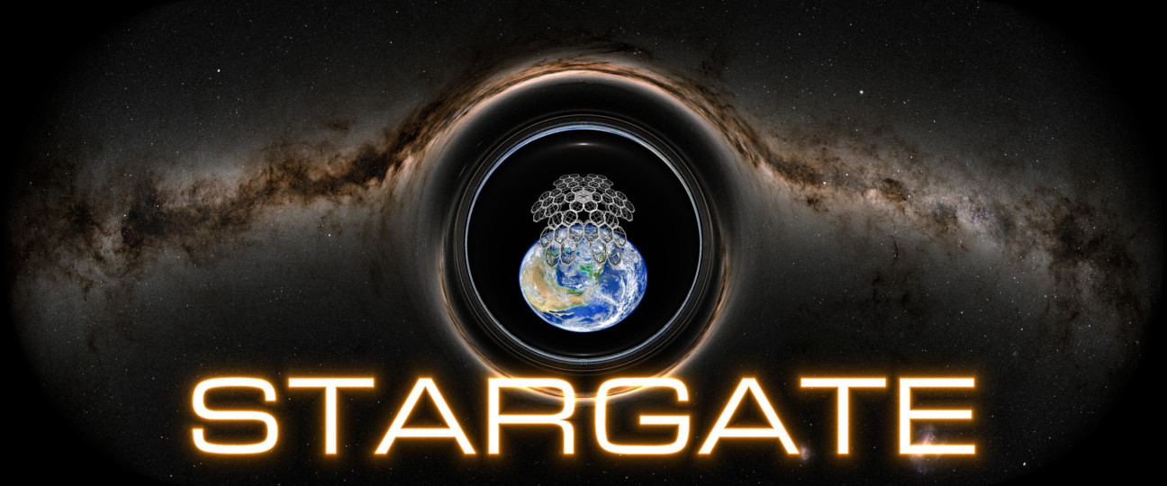

International Lunar Development under the Artemis Accords:
A Scientist’s Perspective
Teviet Creighton
STARGATE Project Lead

Slide 2
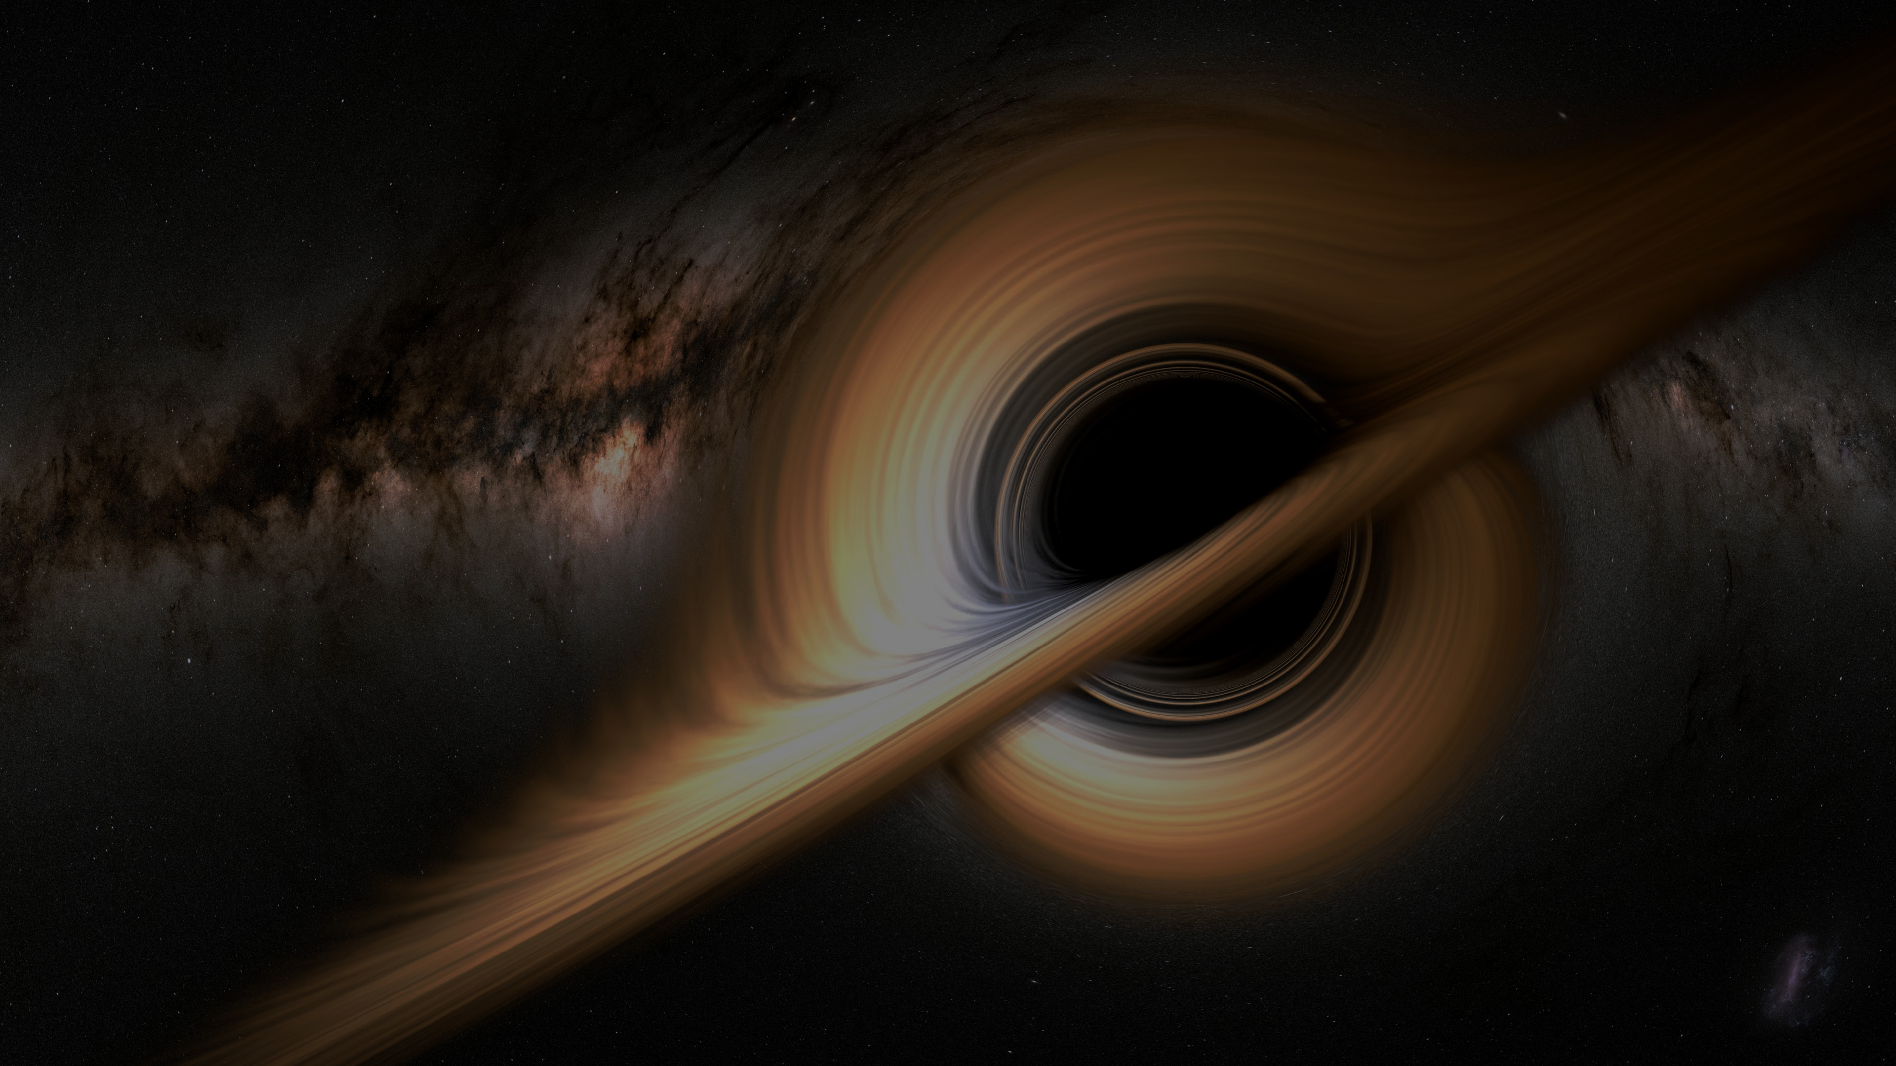
My Background
Theoretical astrophysics ↔ Radio astronomy ↔ Space R&D
Many international collaborations, including:
◦ LIGO-Virgo-KAGRA collaboration
◦ LISA International Science Team
◦ Chinese-American Kavli Frontiers of Science
STARGATE space technology commercialization program

Slide 3
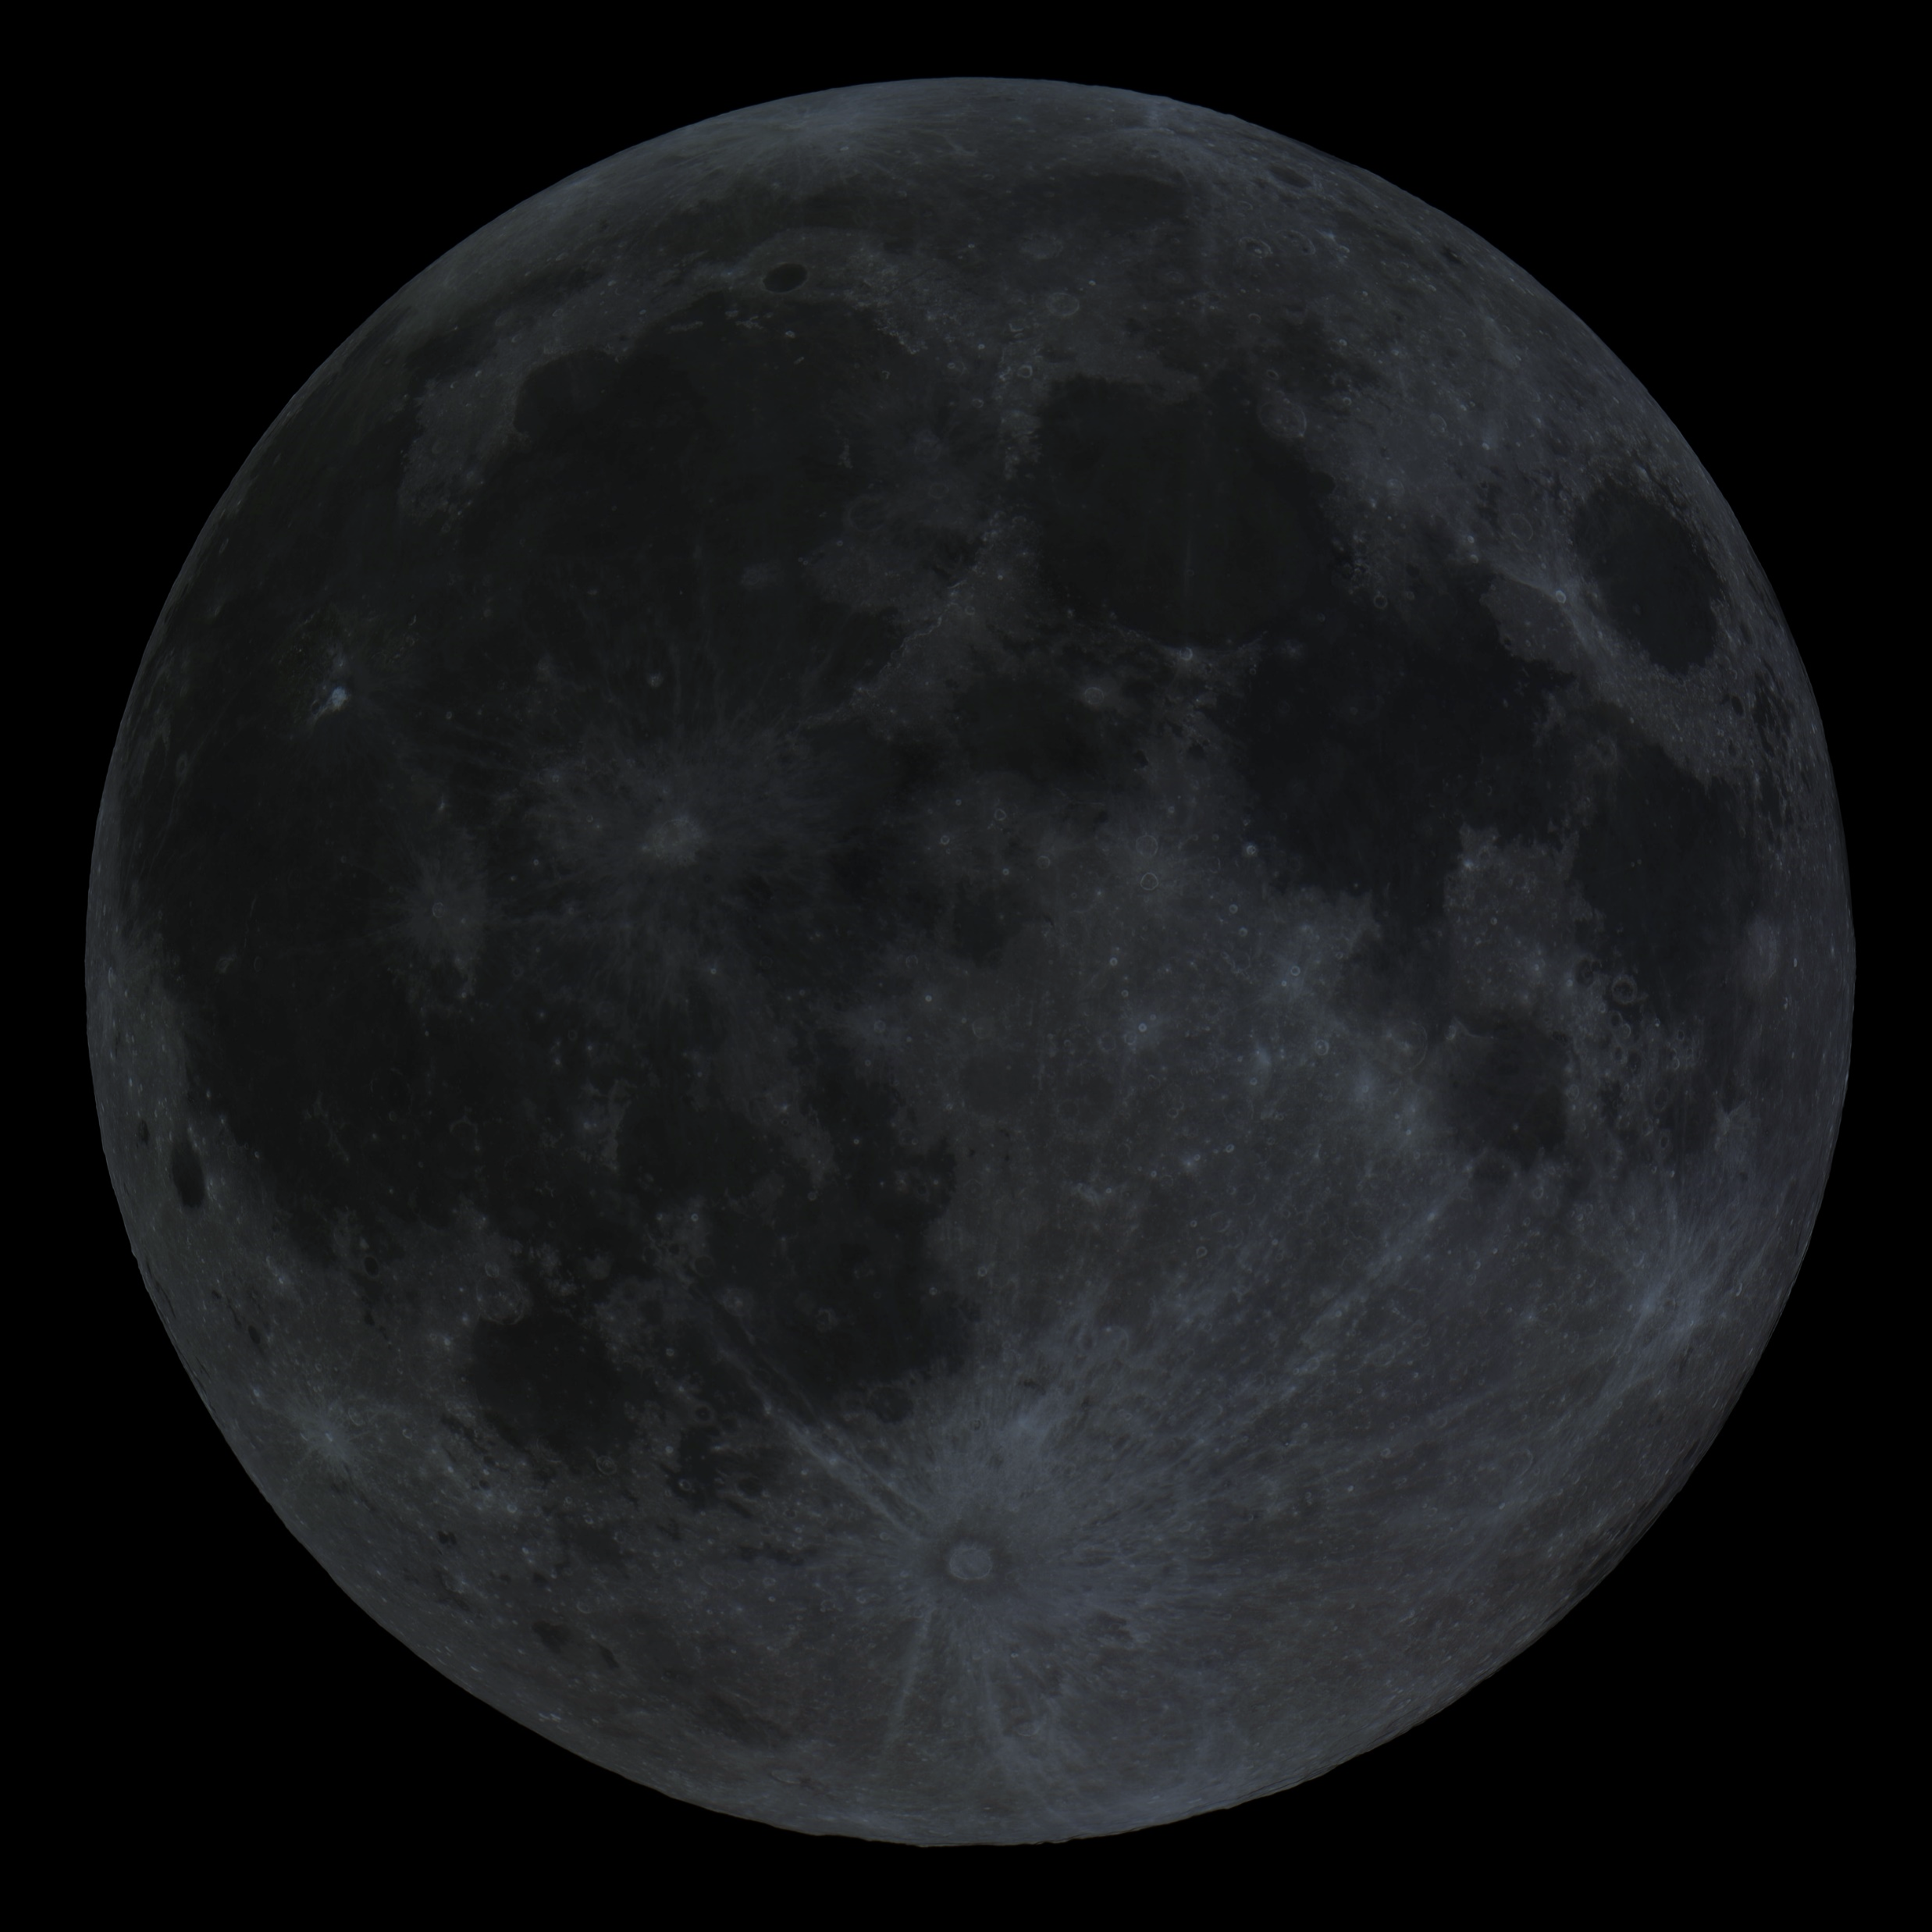
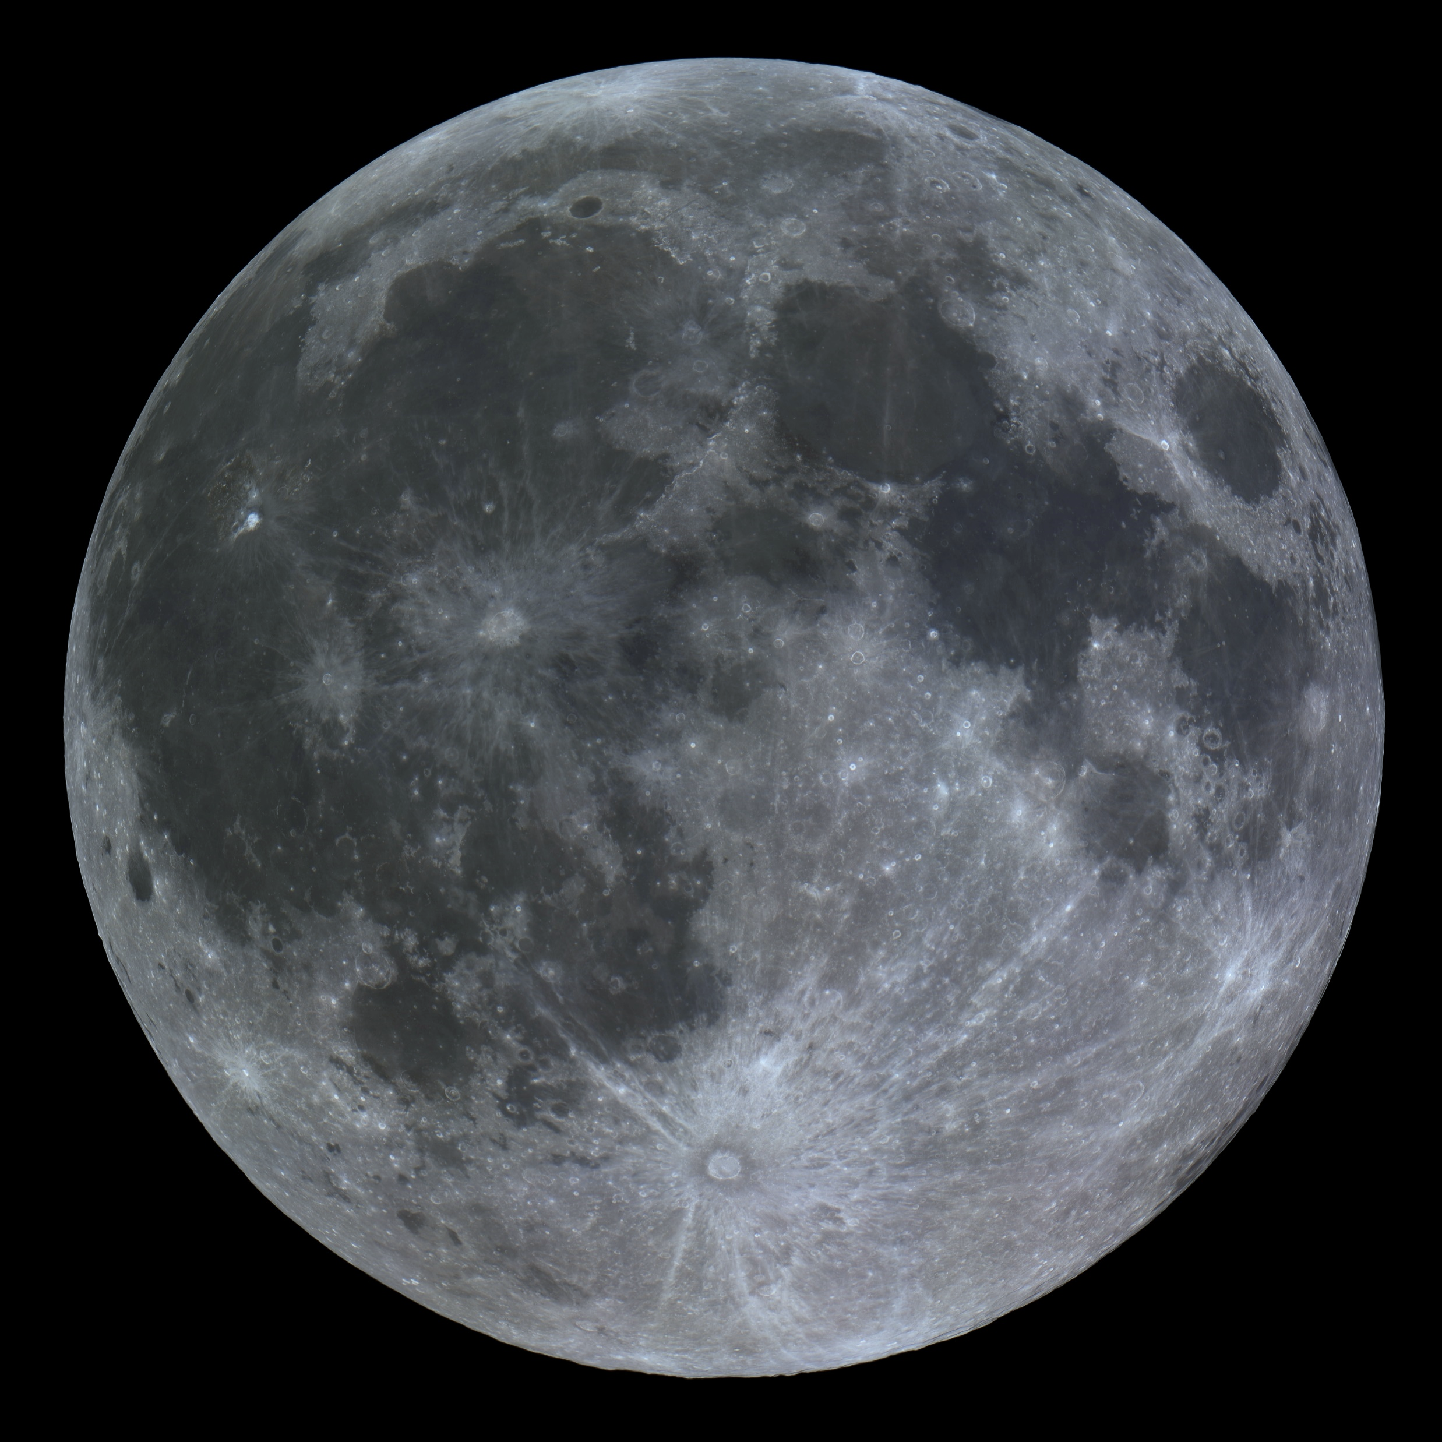
The Moon is…
} ^{Scientist}
} ^{Entrepreneur}
… The province of all humankind, to be explored and used for the benefit of all countries.
… The new frontier, offering wealth and opportunity to bold pioneers willing to stake their claim.
… The ultimate strategic “high ground”, control of which is essential for the national security of [insert country here].
How do we reconcile these different visions?

Slide 4
Law of the Land: The Outer Space Treaty
Article I: The exploration and use of outer space, including the Moon … shall be carried out for the benefit and in the interests of all countries, irrespective of their degree of economic or scientific development, and shall be the province of all mankind.
Outer space, including the Moon and other celestial bodies, shall be free for exploration and use by all States without discrimination … and there shall be free access to all areas of celestial bodies.
There shall be freedom of scientific investigation in outer space … and States shall facilitate and encourage international cooperation.
Article II: Outer space, including the Moon and other celestial bodies, is not subject to national appropriation by claim of sovereignty, by means of use or occupation, or by any other means.
The Moon belongs to everyone.
Anyone is free to go wherever they want.
You can’t lay claim to it.

Slide 5
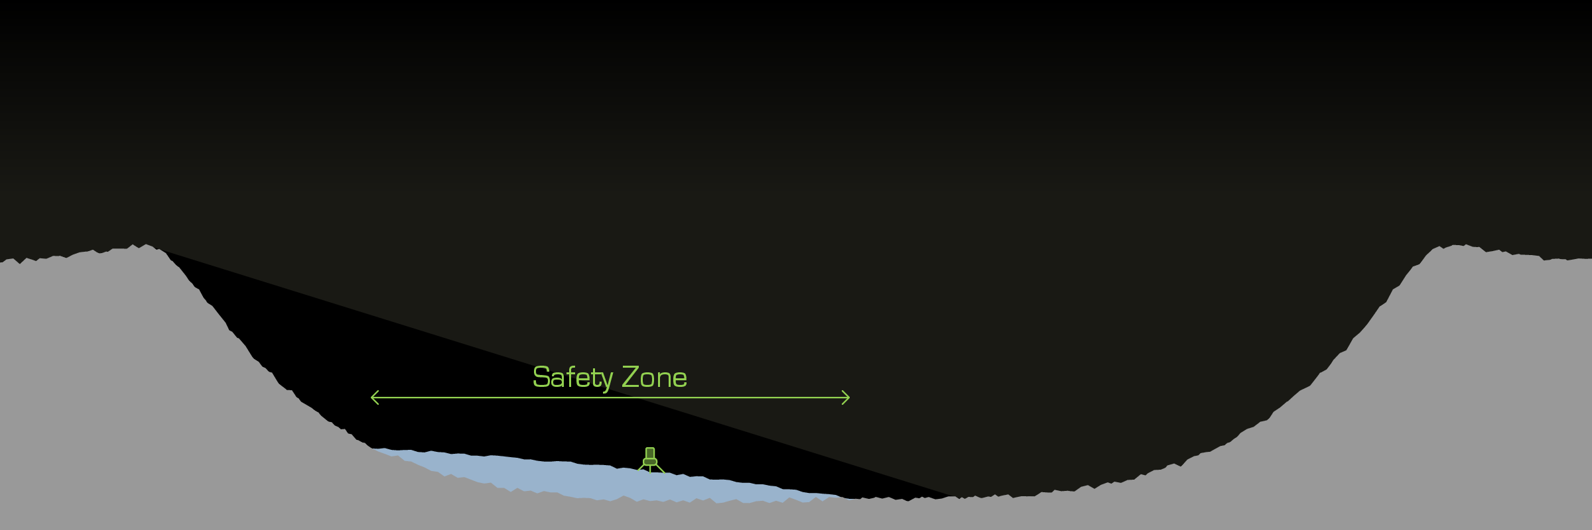


Outer Space Treaty → Artemis Accords
But…
You shouldn’t interfere with activities of others.
Article IX: … If a State Party to the Treaty has reason to believe that an activity or experiment planned by it or its nationals … would cause potentially harmful interference with activities of other States Parties in the peaceful exploration and use of outer space … it shall undertake appropriate international consultations before proceeding with any such activity.
Artemis Accords: The area wherein this notification and coordination will be implemented to avoid harmful interference is referred to as a ‘safety zone’.
Who adjudicates these ‘safety zones’?

Slide 6
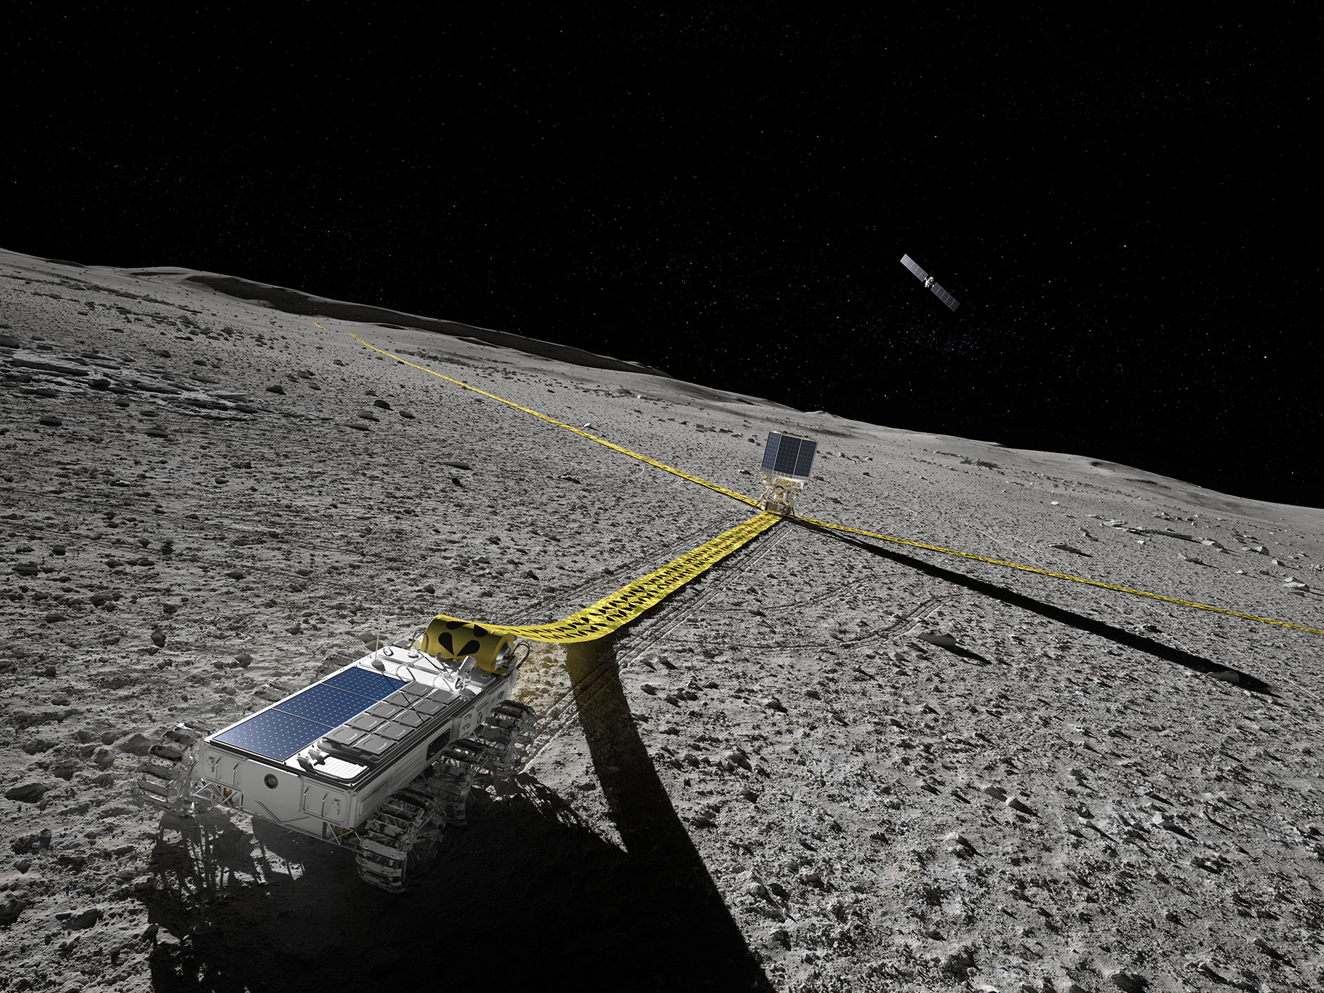
Example: Lunar Radio Quiet Zone
Credit: Peter Sanitra

Slide 7
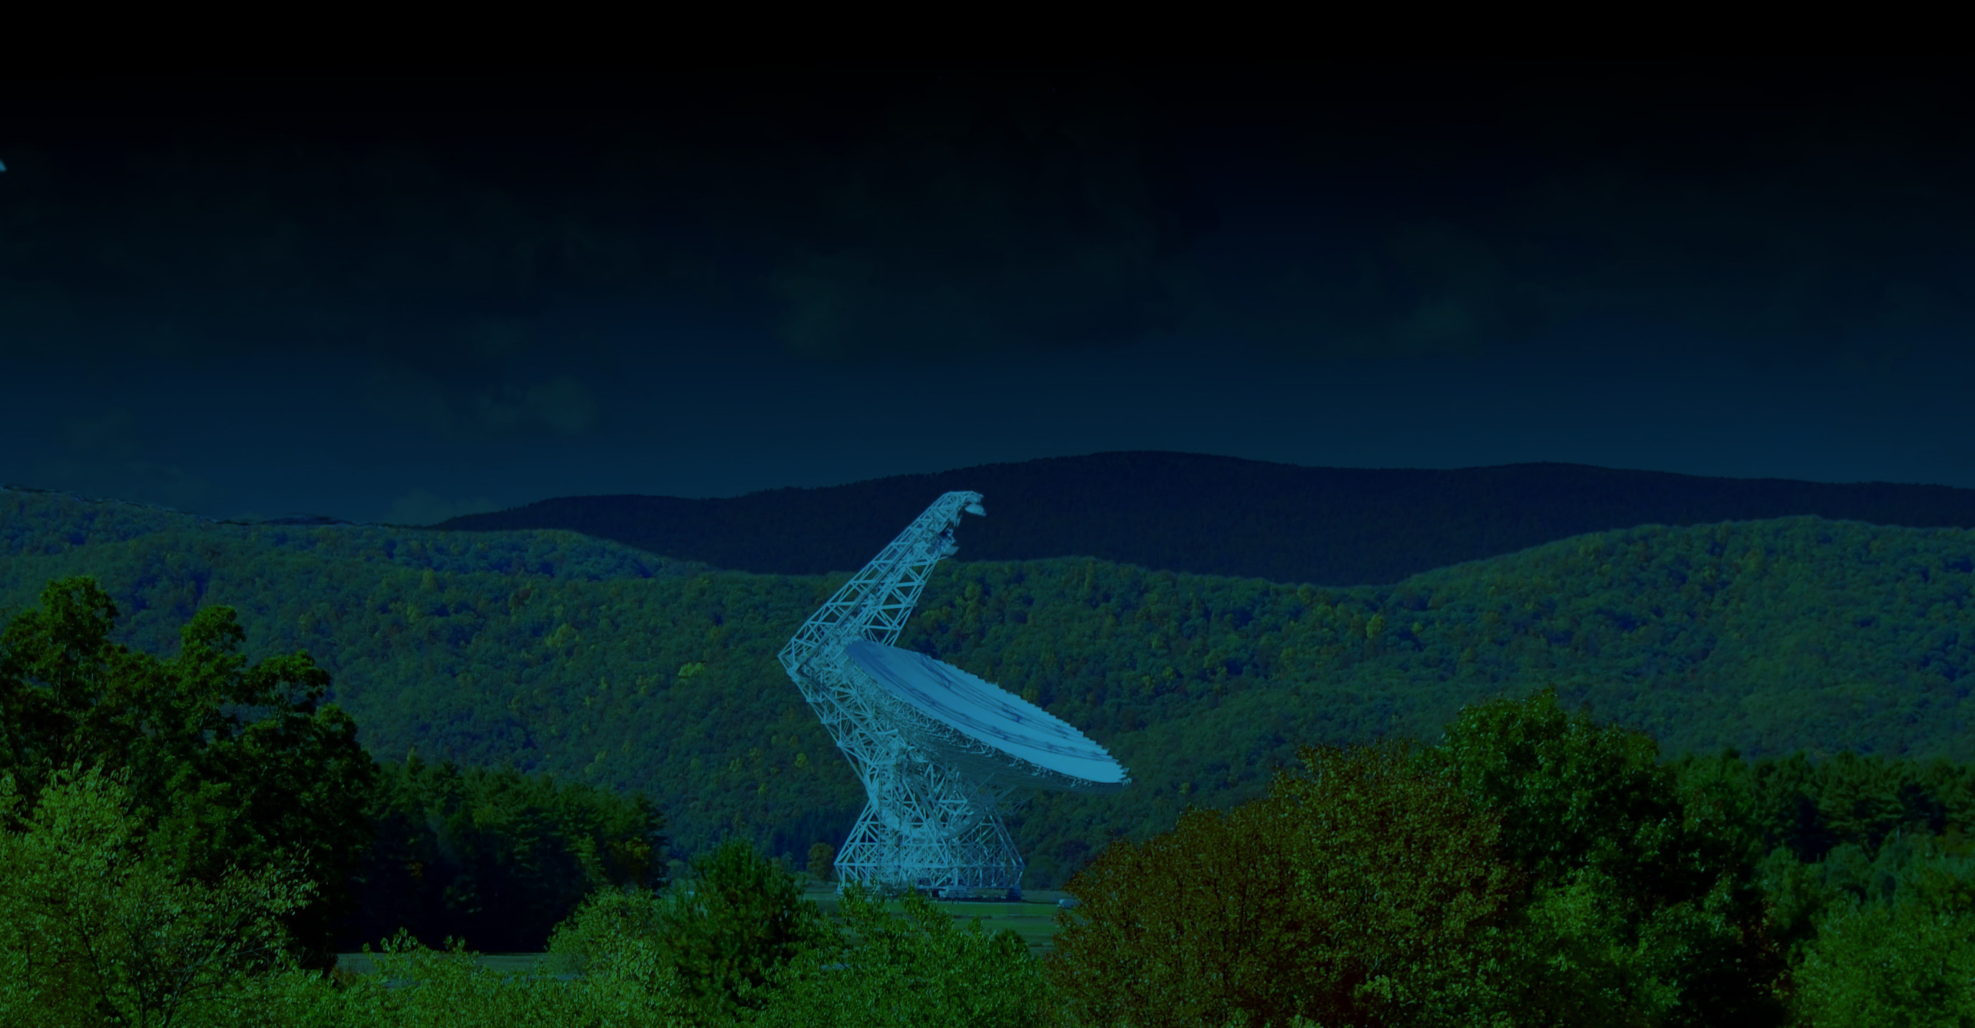
Example: National Radio Quiet Zone
How does NRAO enforce it?
They don’t!
When radio interference is identified:
Ask politely to shut it off.
Offer free servicing and alternative devices.
Bow to the inevitable and develop mitigation methods.
Credit: NRAO/AUI/NSF

Slide 8
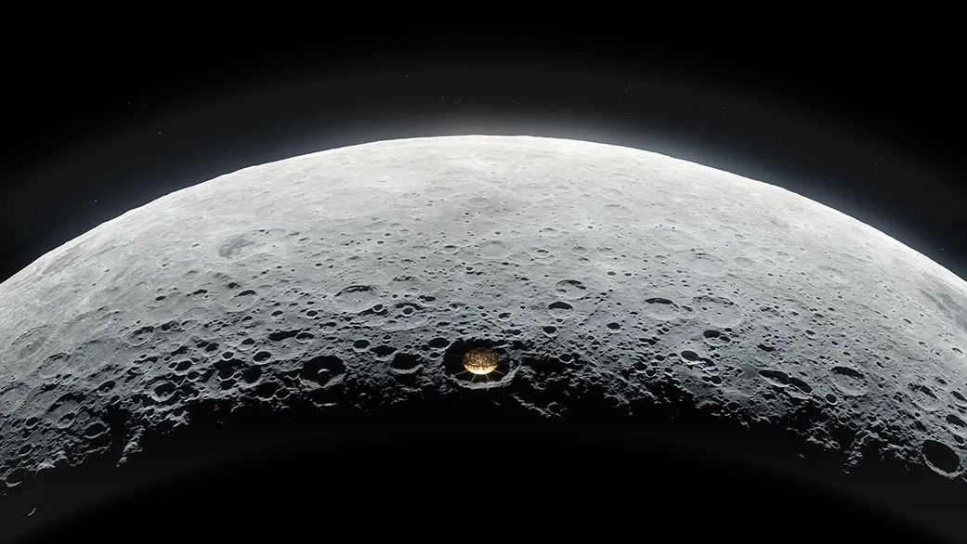
Example: Lunar Radio Quiet Zone
Have deconfliction strategies.
Communicate.
Collaborate.
Mitigate / circumvent.
Credit: Vladimir Vustyanski

Slide 9
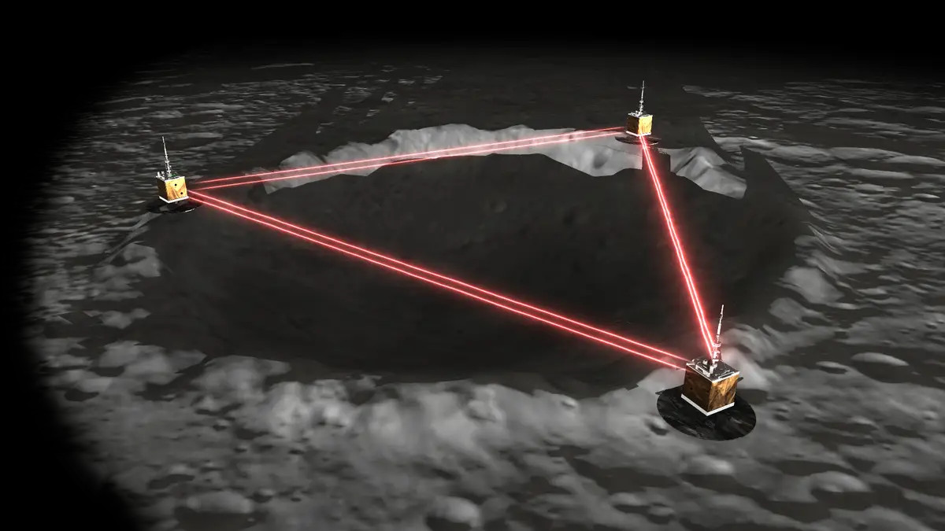
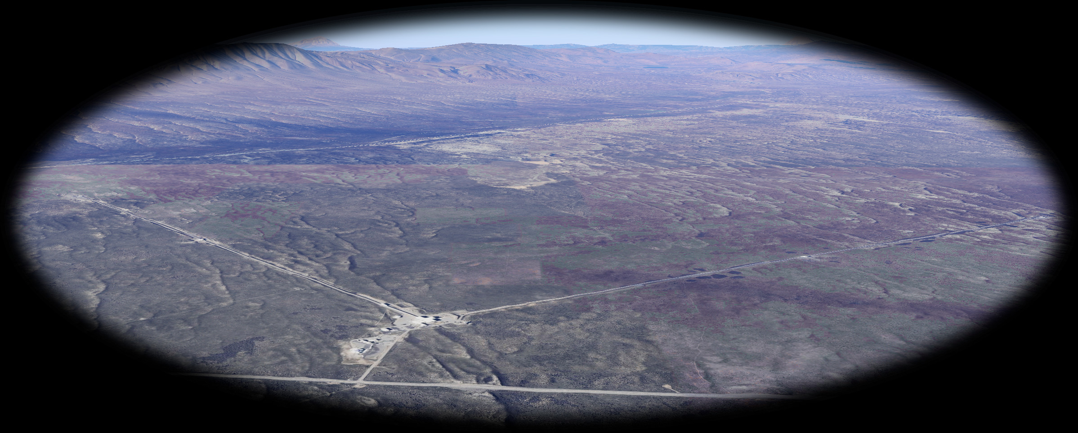
Example: Lunar Gravitational-Wave Detector
Requires large area (40+ km crater) with no
other activity (dust).
Pick a place that nobody else
could possibly want!
Credit: Vanderbilt Lunar Labs Initiative
Credit: Google Maps

Slide 10
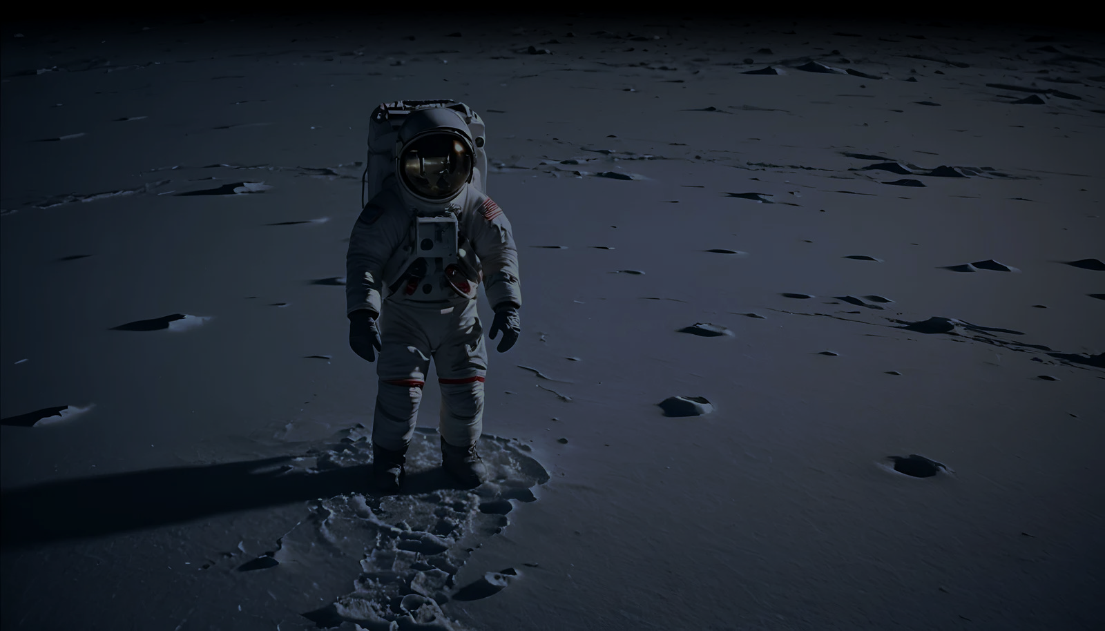
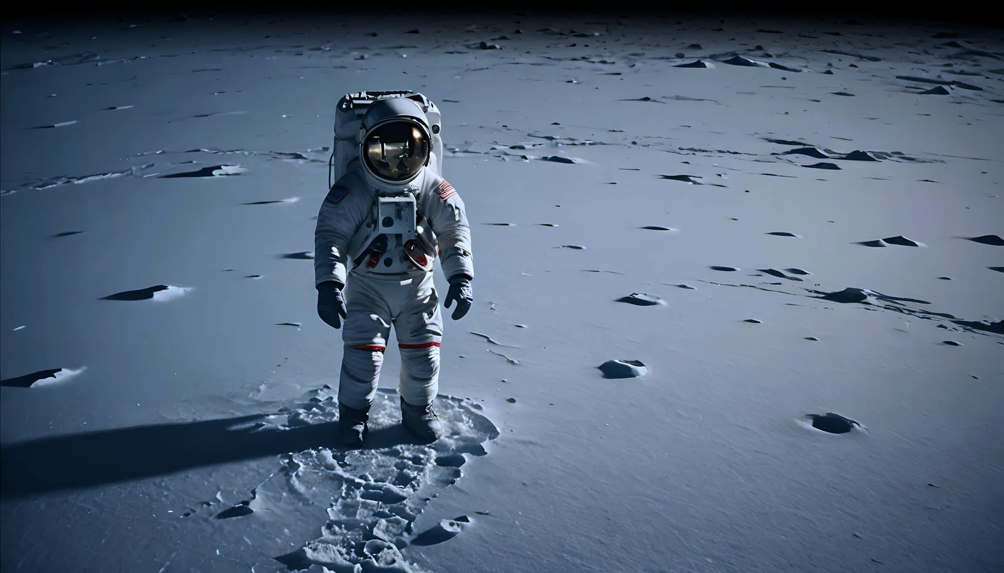
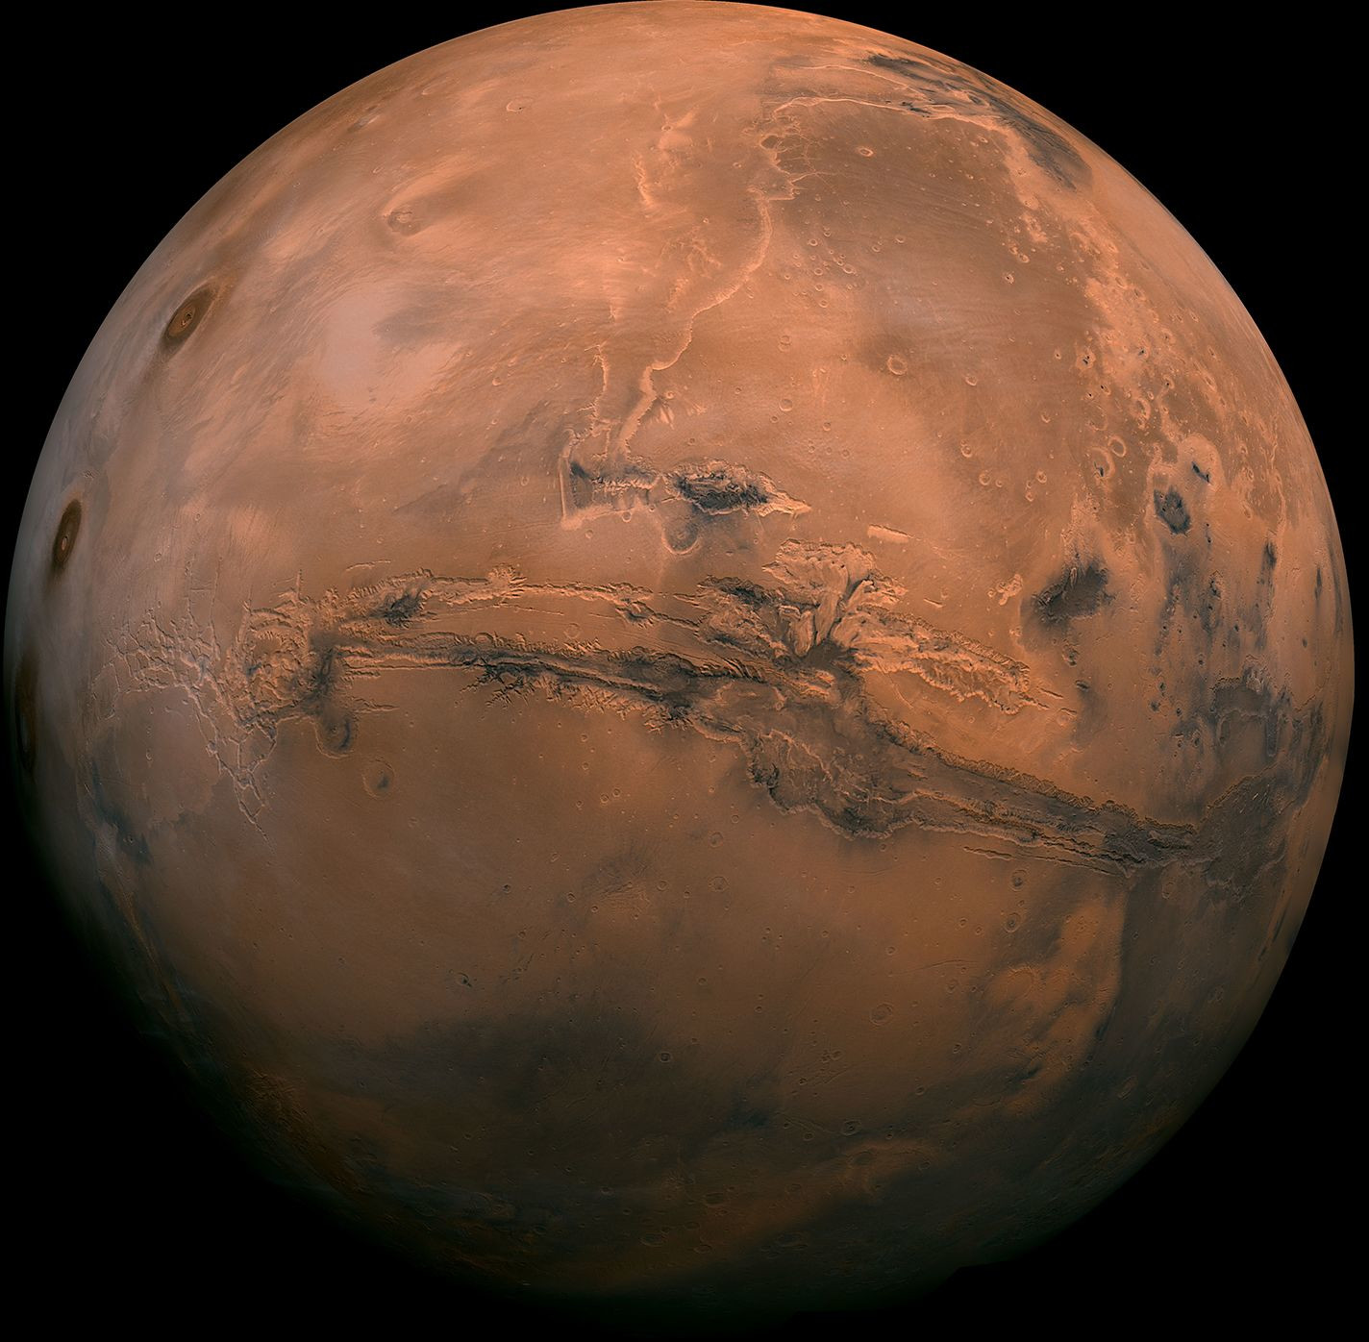
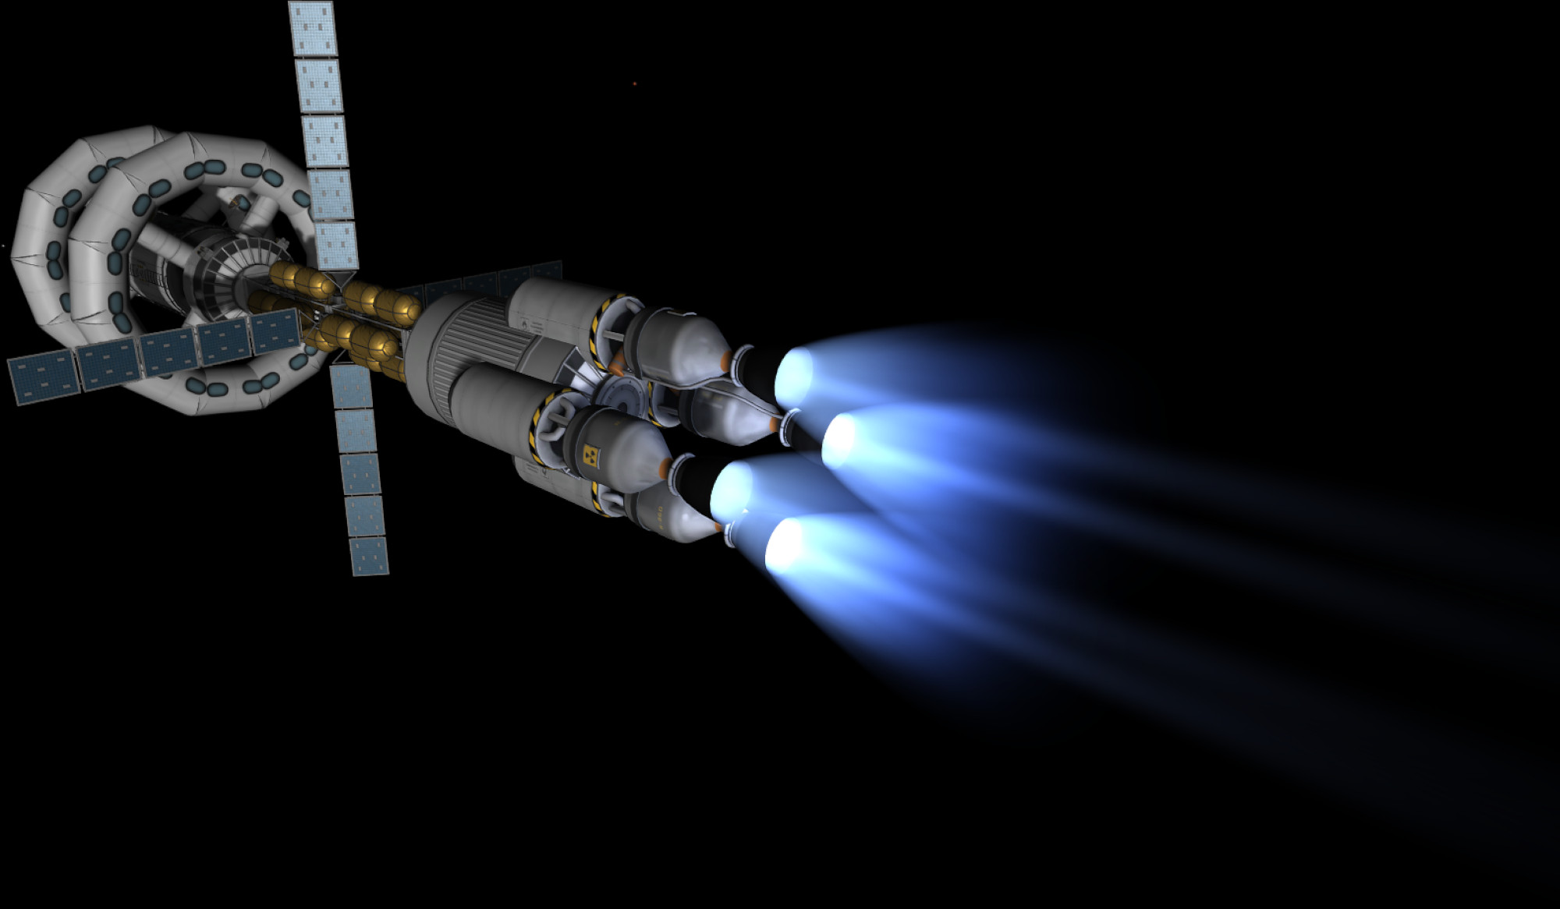
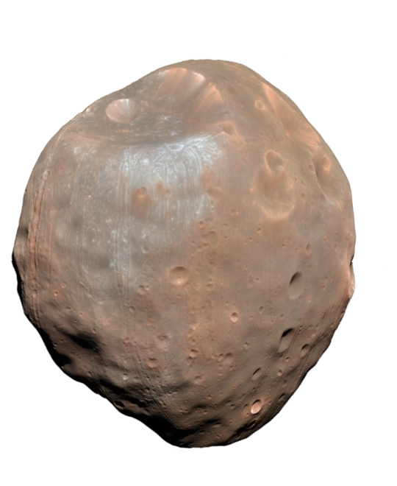
Example: Lunar Ice Mining
Businessperson: How do we secure Lunar water rights?
Scientist: Whyever would you go to the Moon to get water?
Entrepreneur: Find alternatives!
Credit: NightCafe

Slide 11
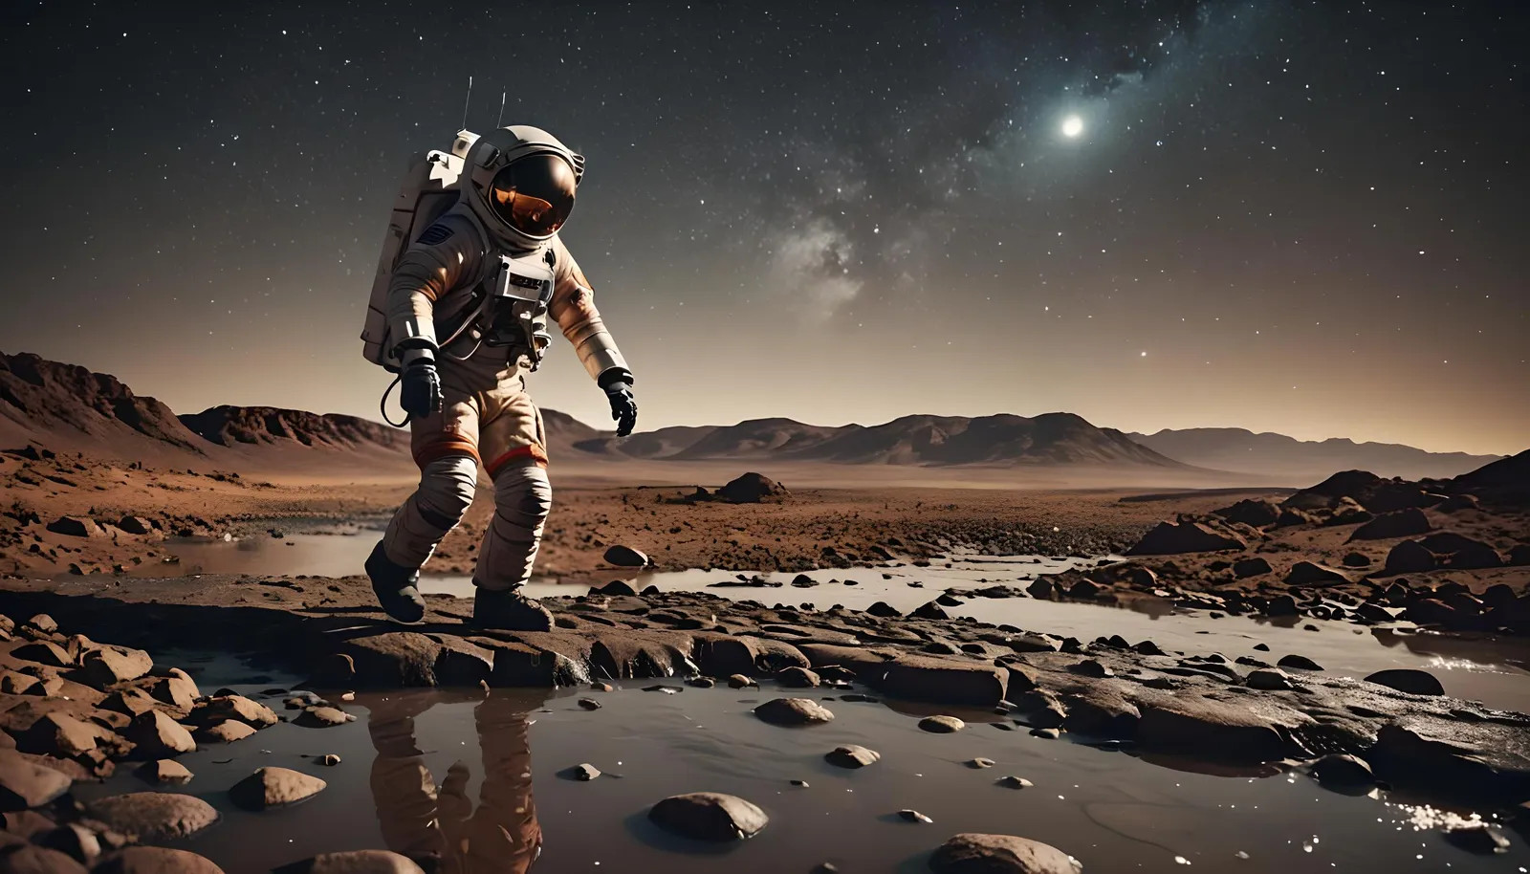
The Moon is a Stepping Stone …
Do use for activities for which it is uniquely suited
Scientific investigation
Testing ground for technology
Source of materials that it has in abundance (Fe, Mg, Al, Si, O)
Don’t use for things that depend on scarce resources
Fueling depot (hydrogen)
Large-scale human habitation
Credit: NightCafe

Slide 12
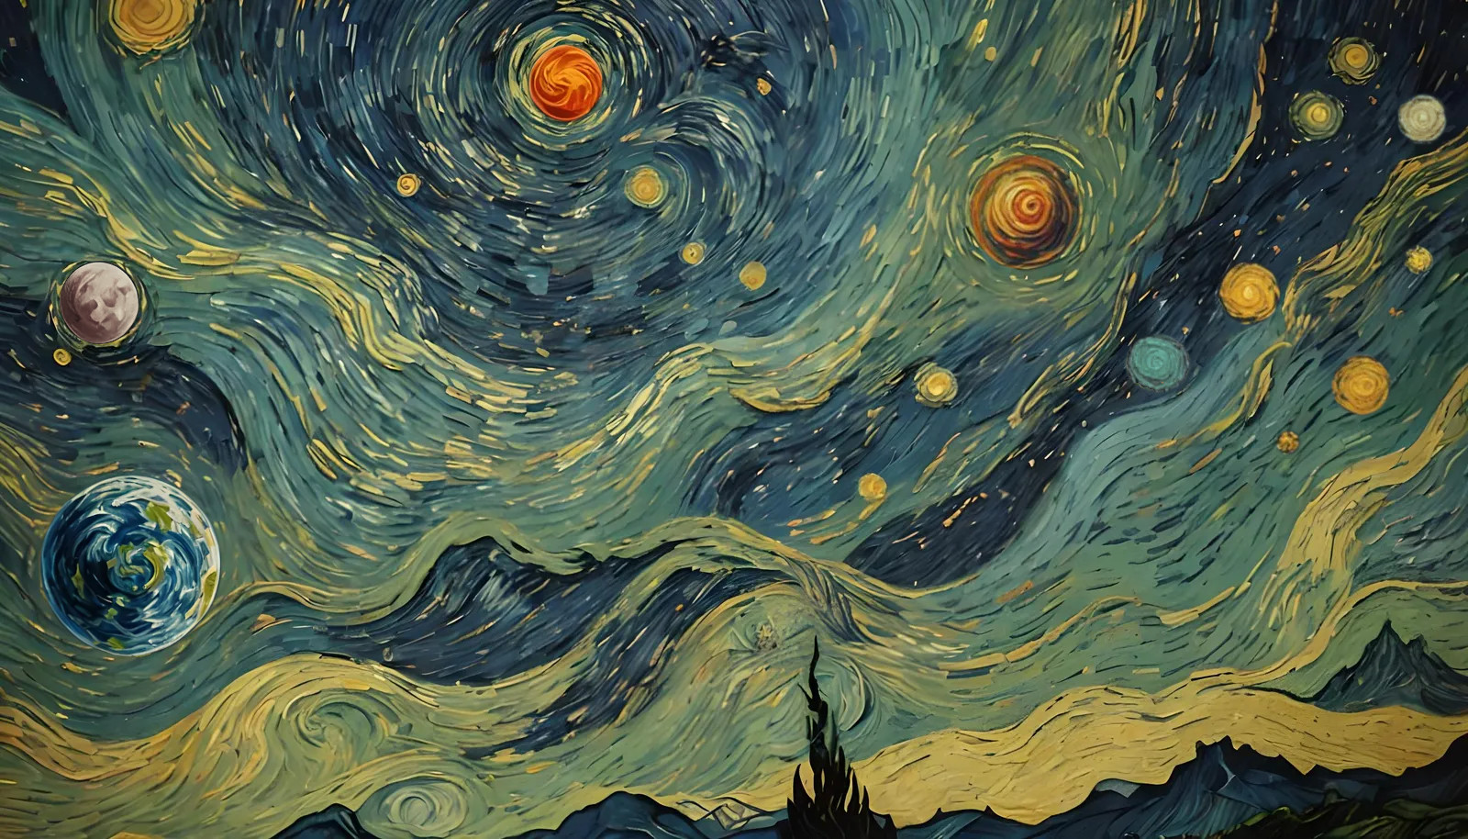
The Moon is a Stepping Stone … not a settlement!
Scarcity
Abundance
∆
Credit: NightCafe

