Slide 1



Teviet Creighton

Slide 2
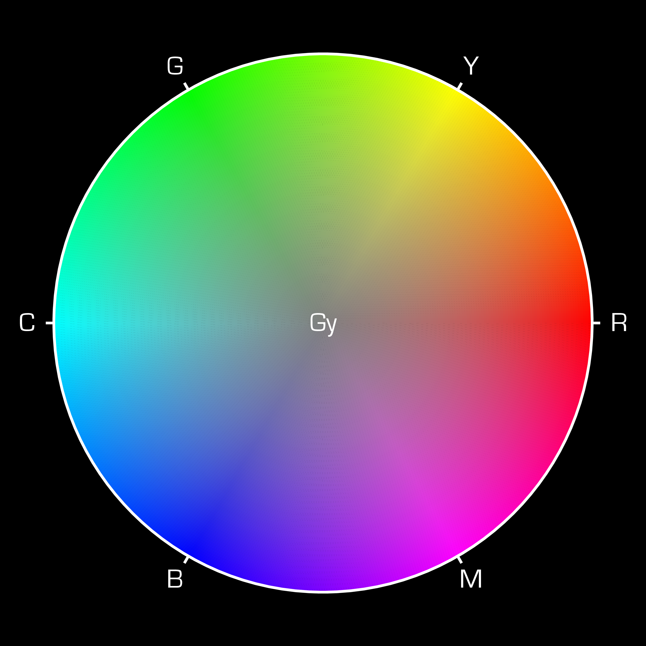
Outline
Physical basis of light
Physical basis of colour
Biological perception of light
Biological perception of colour
Representation of colour
Colour addition
Colour subtraction

Slide 3
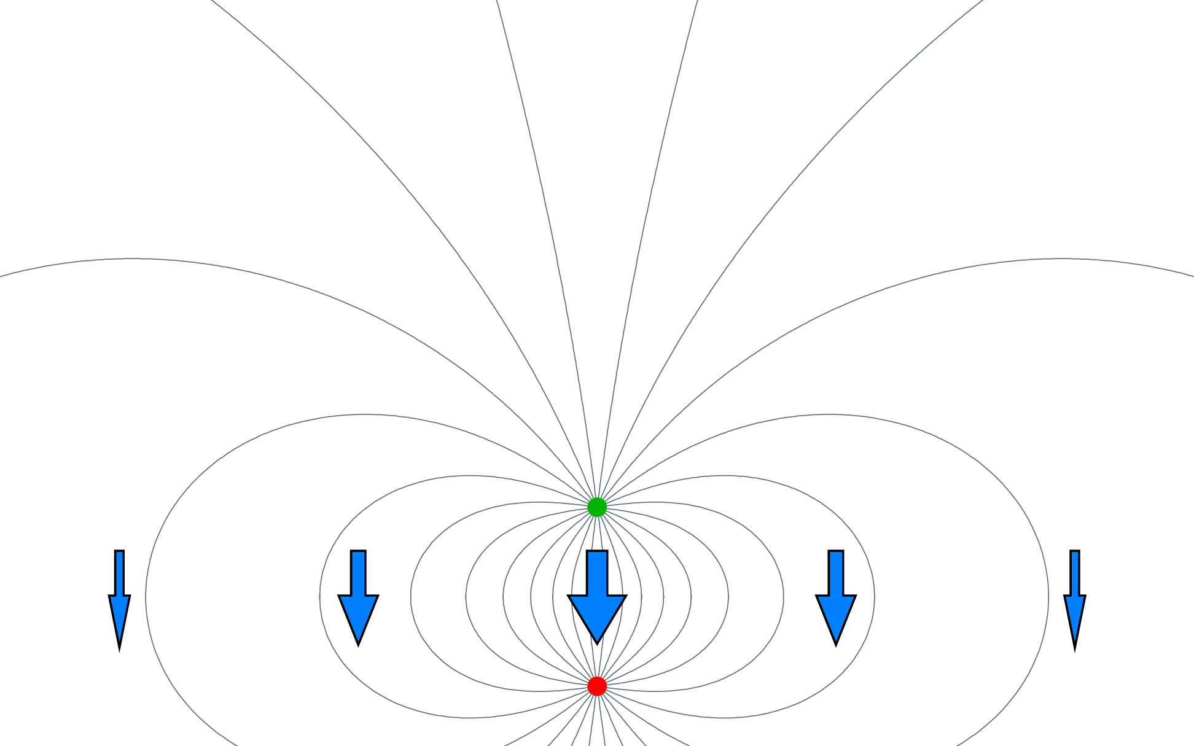

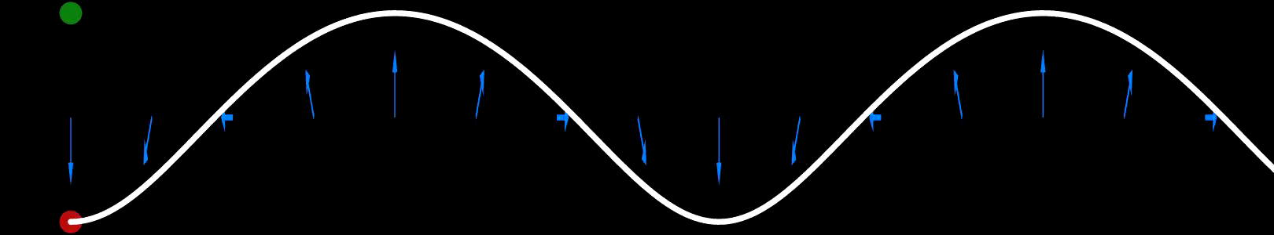
Physical Basis of Light
Matter consists of + and − electric charges
Electric fields point from + to −
Changing field spreads as an electromagnetic wave

Slide 4







Physical Basis of Colour
Electromagnetic waves are light!
Characterized by amplitude, polarization,
direction of propagation, and
wavelength

Slide 5

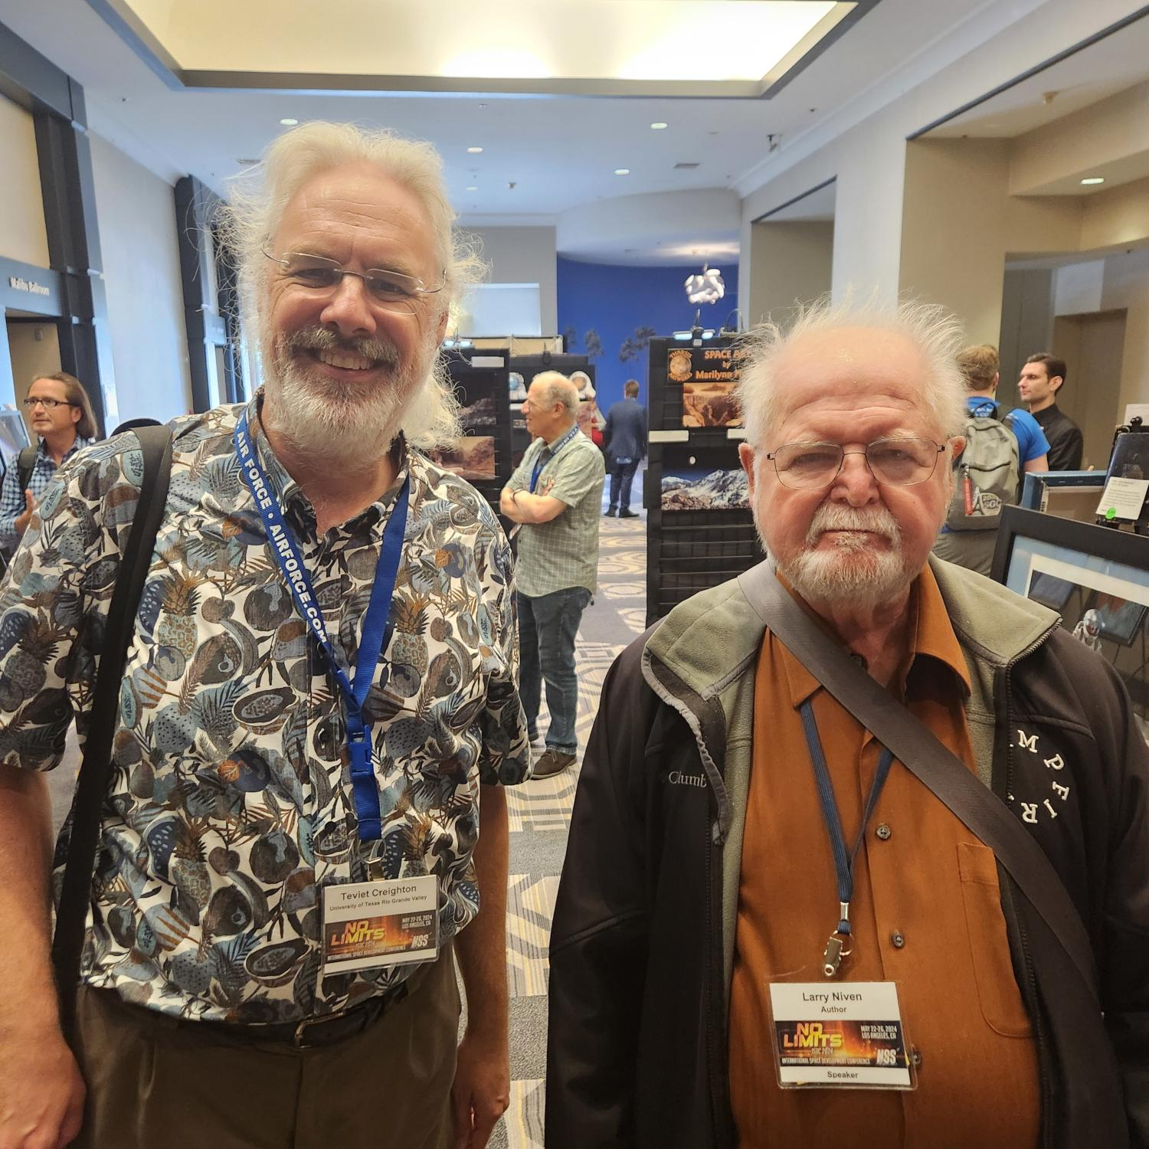
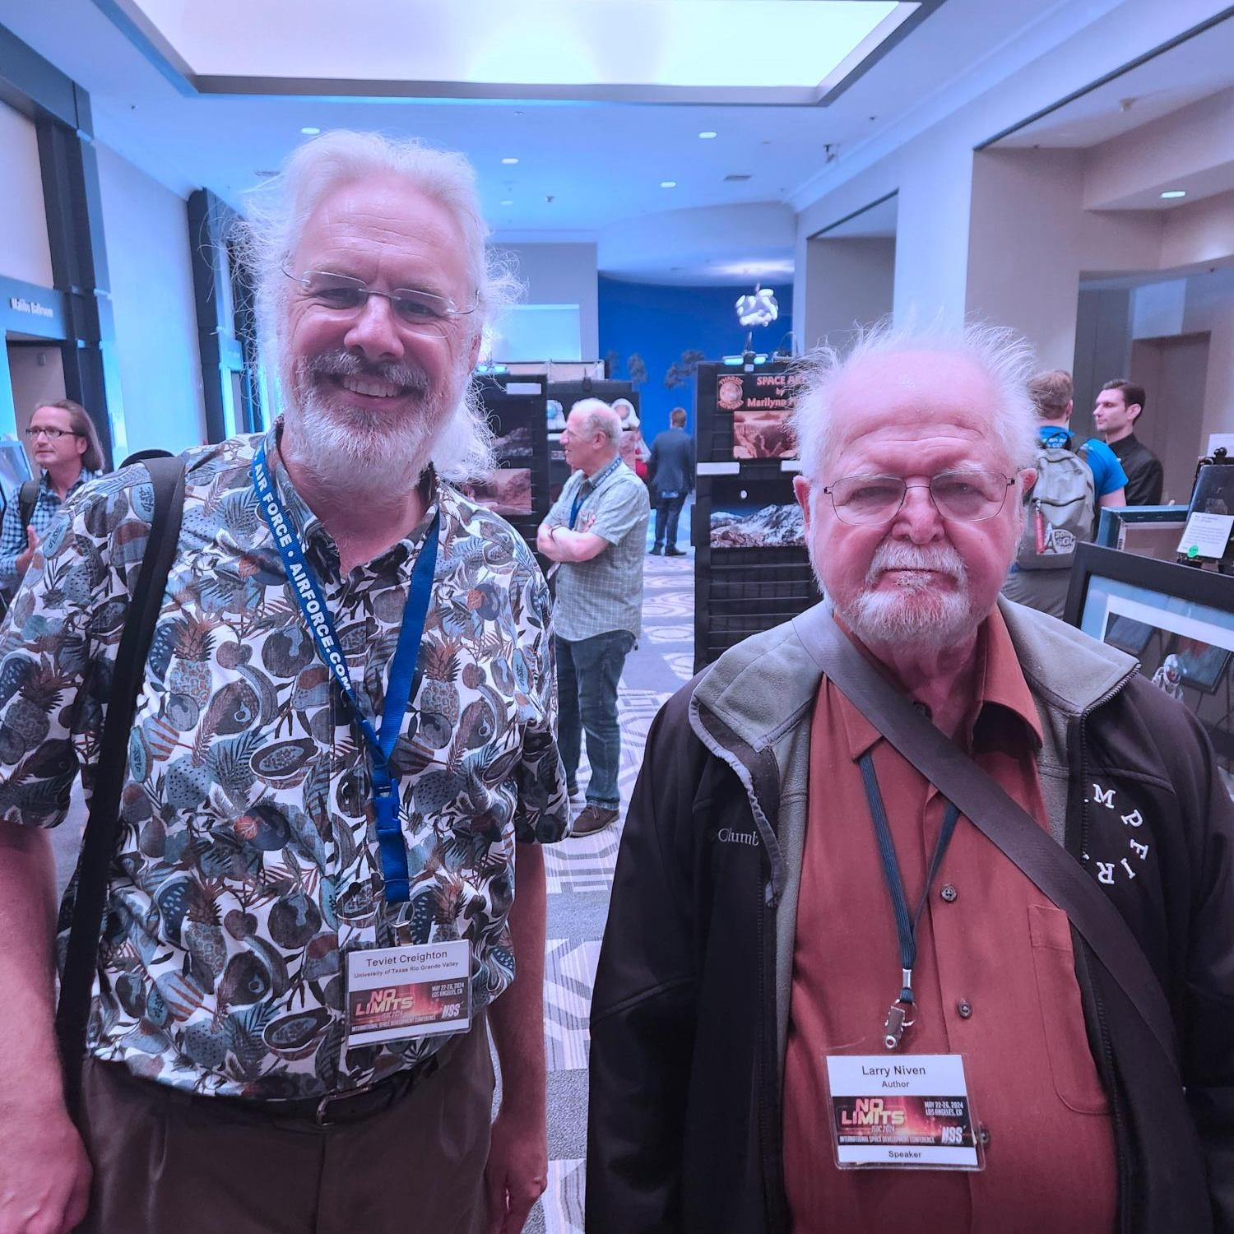
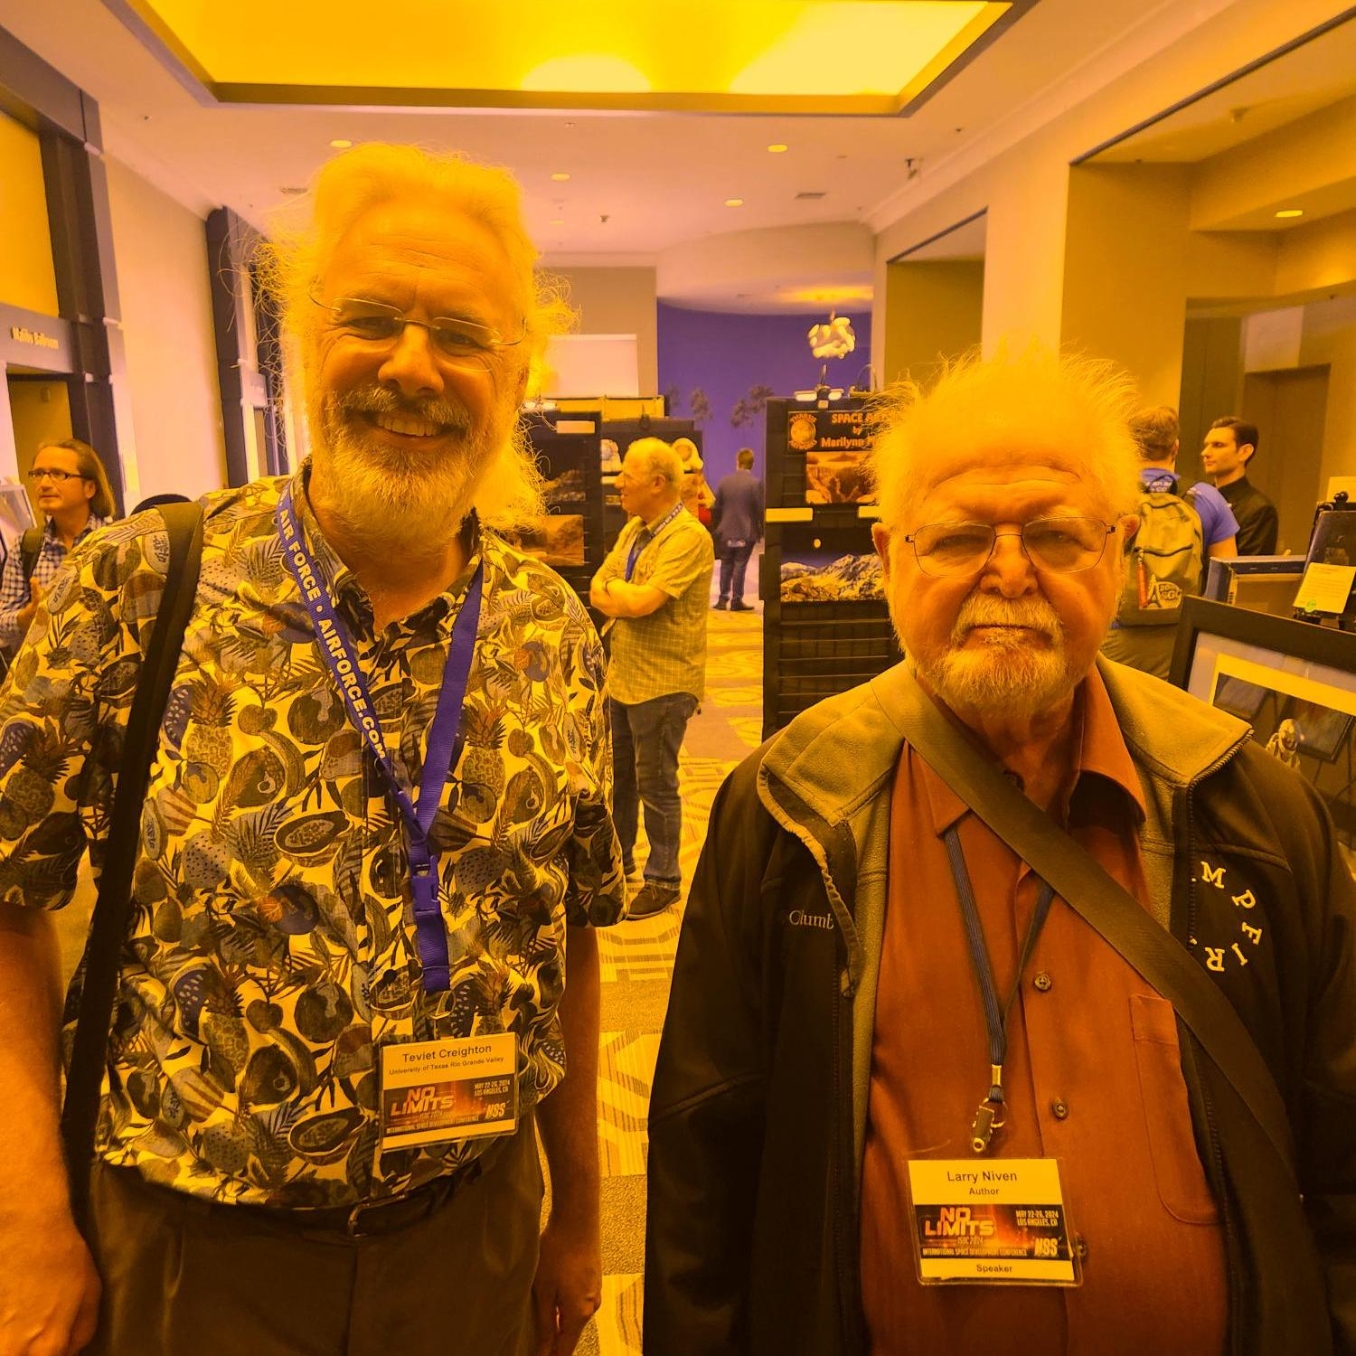
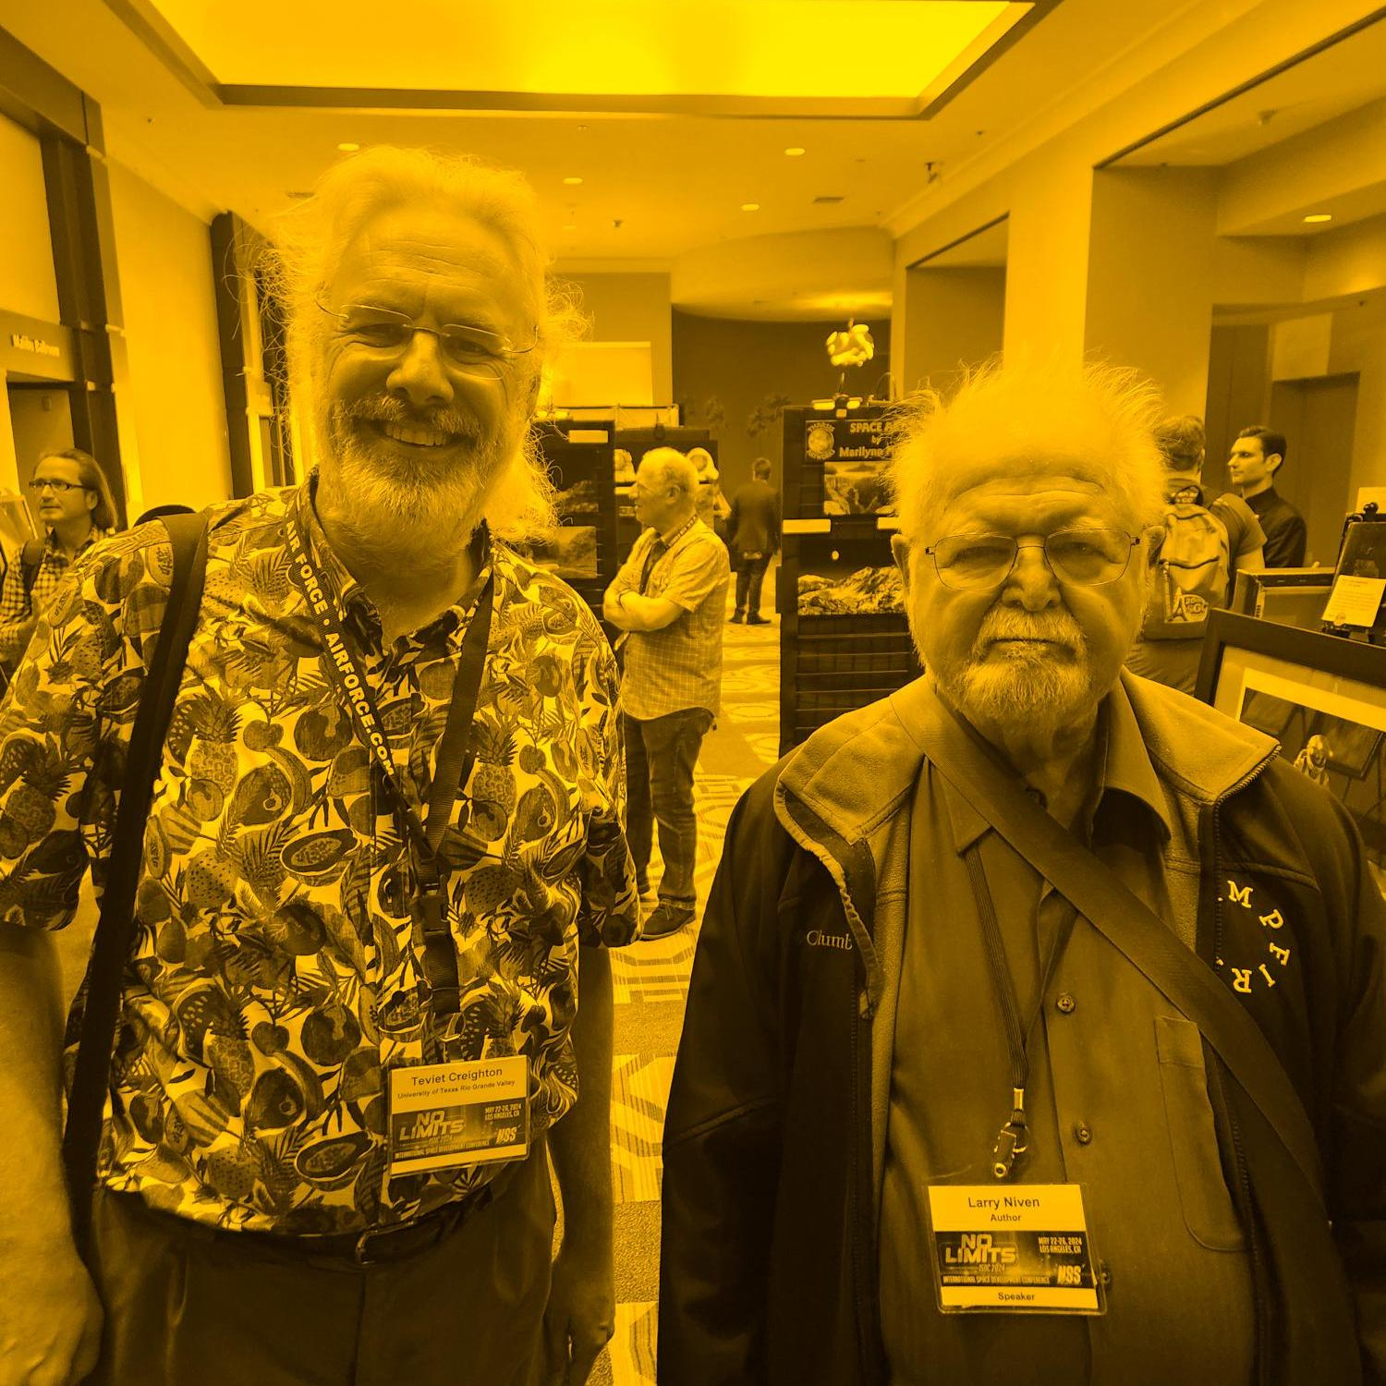
Aside: Colour Temperature
Illuminants assigned a correlated colour temperature based on closest-matching thermal emitter
  Approximate and sometimes counterintuitive!
Sodium Lighting
CCT = 2500K
“Warm” Lighting
CCT = 2500K
“Cool” Lighting
CCT > 10,000K
HDTV Standard White
CCT = 6500K

Slide 6
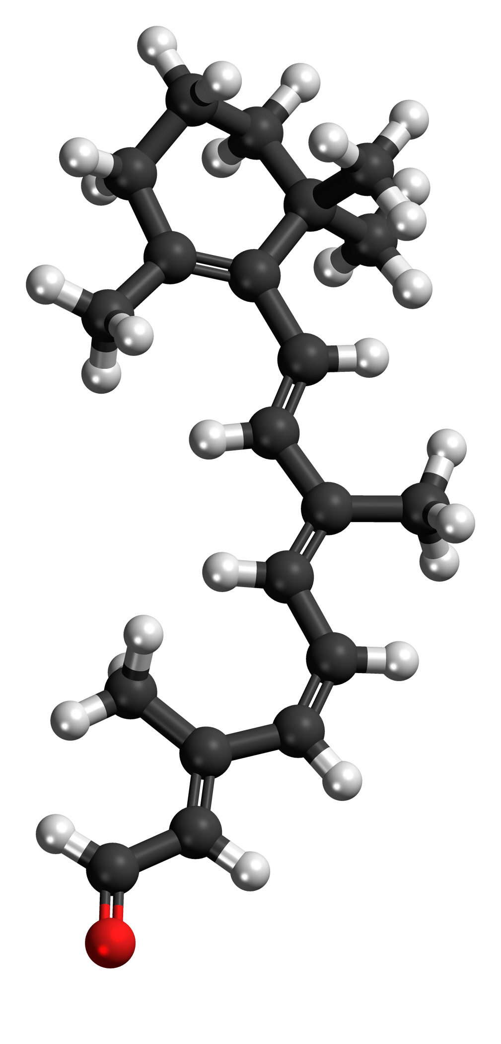
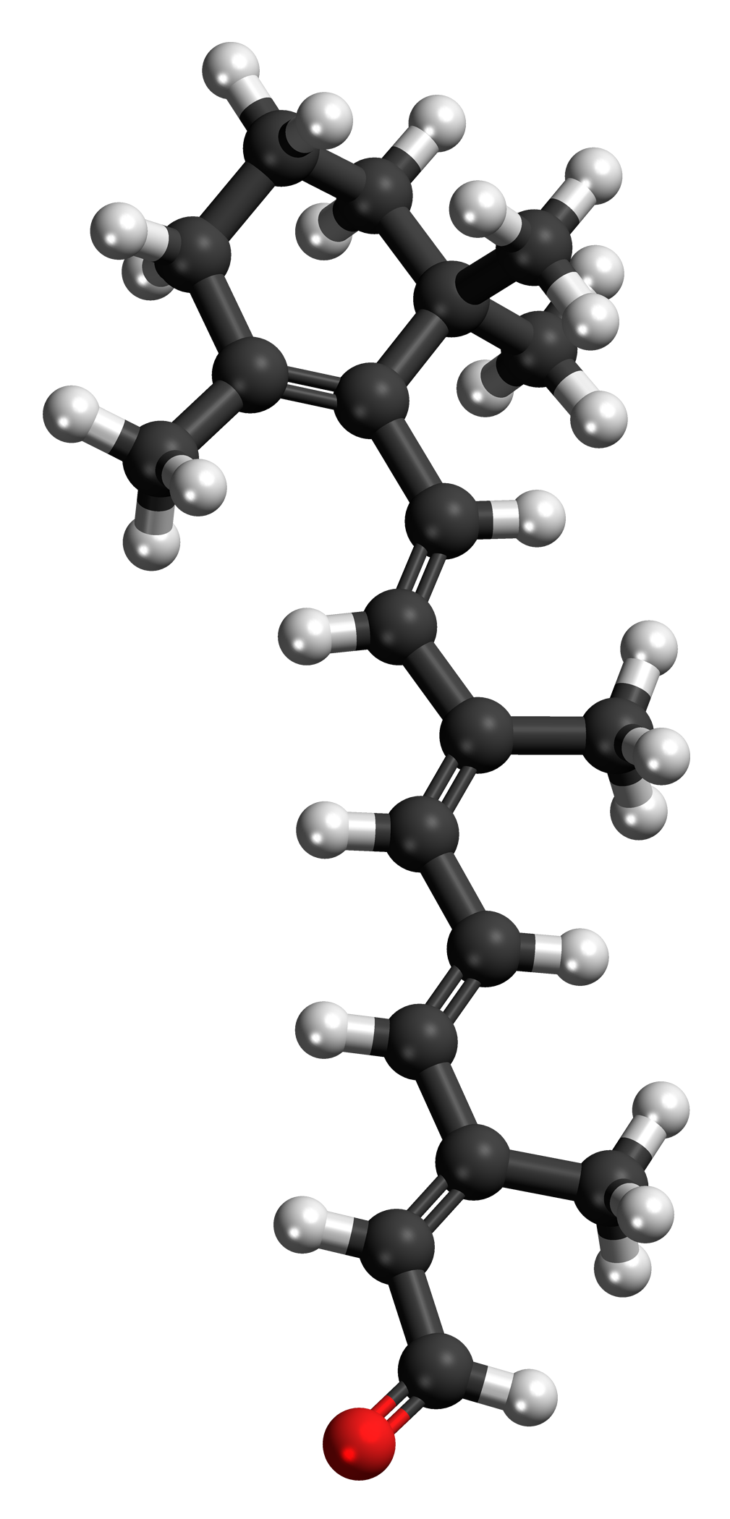

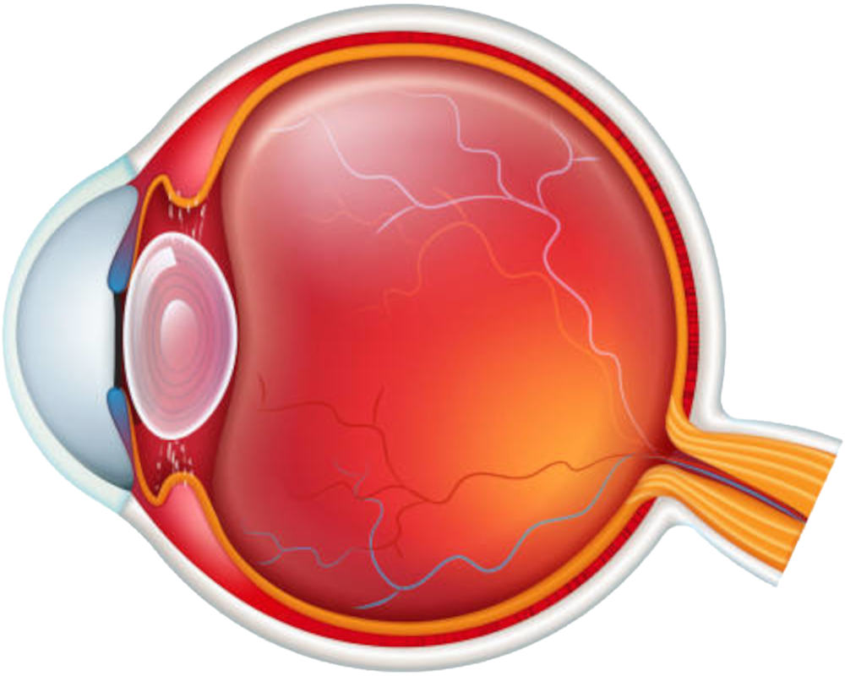
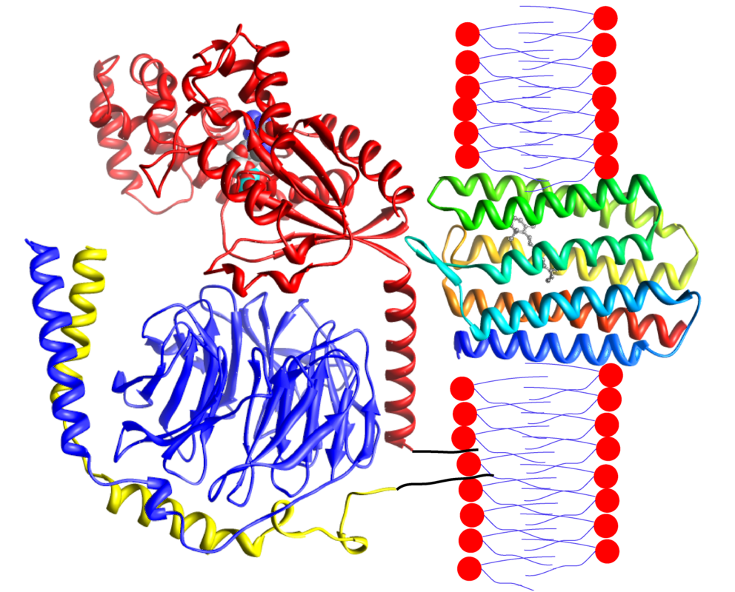
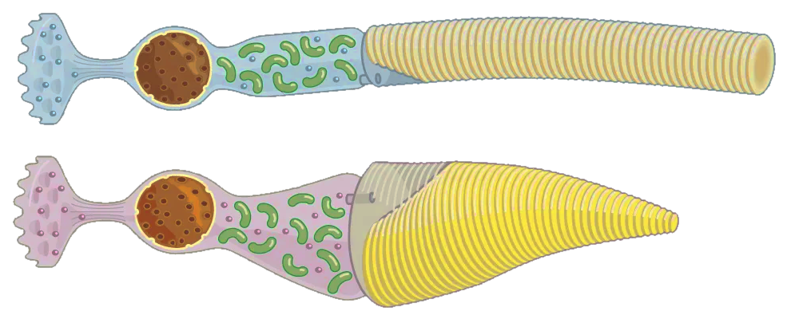

Biological Perception of Light
Eye is a camera!
Aperture (pupil)
Lens
Sensor (retina)
Receptors (rods, cones)
Photopigments (opsins)
Chromophore (retinal)

Slide 7
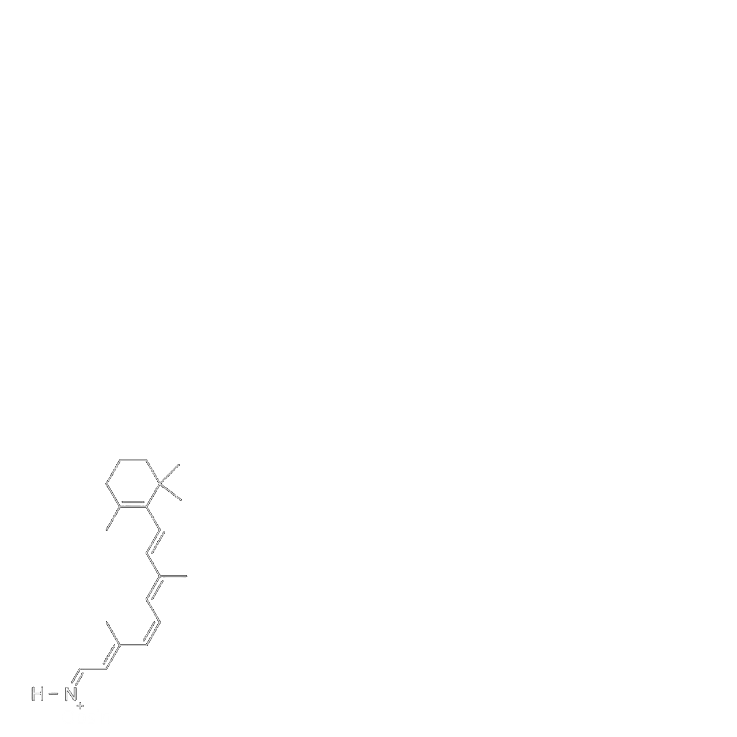
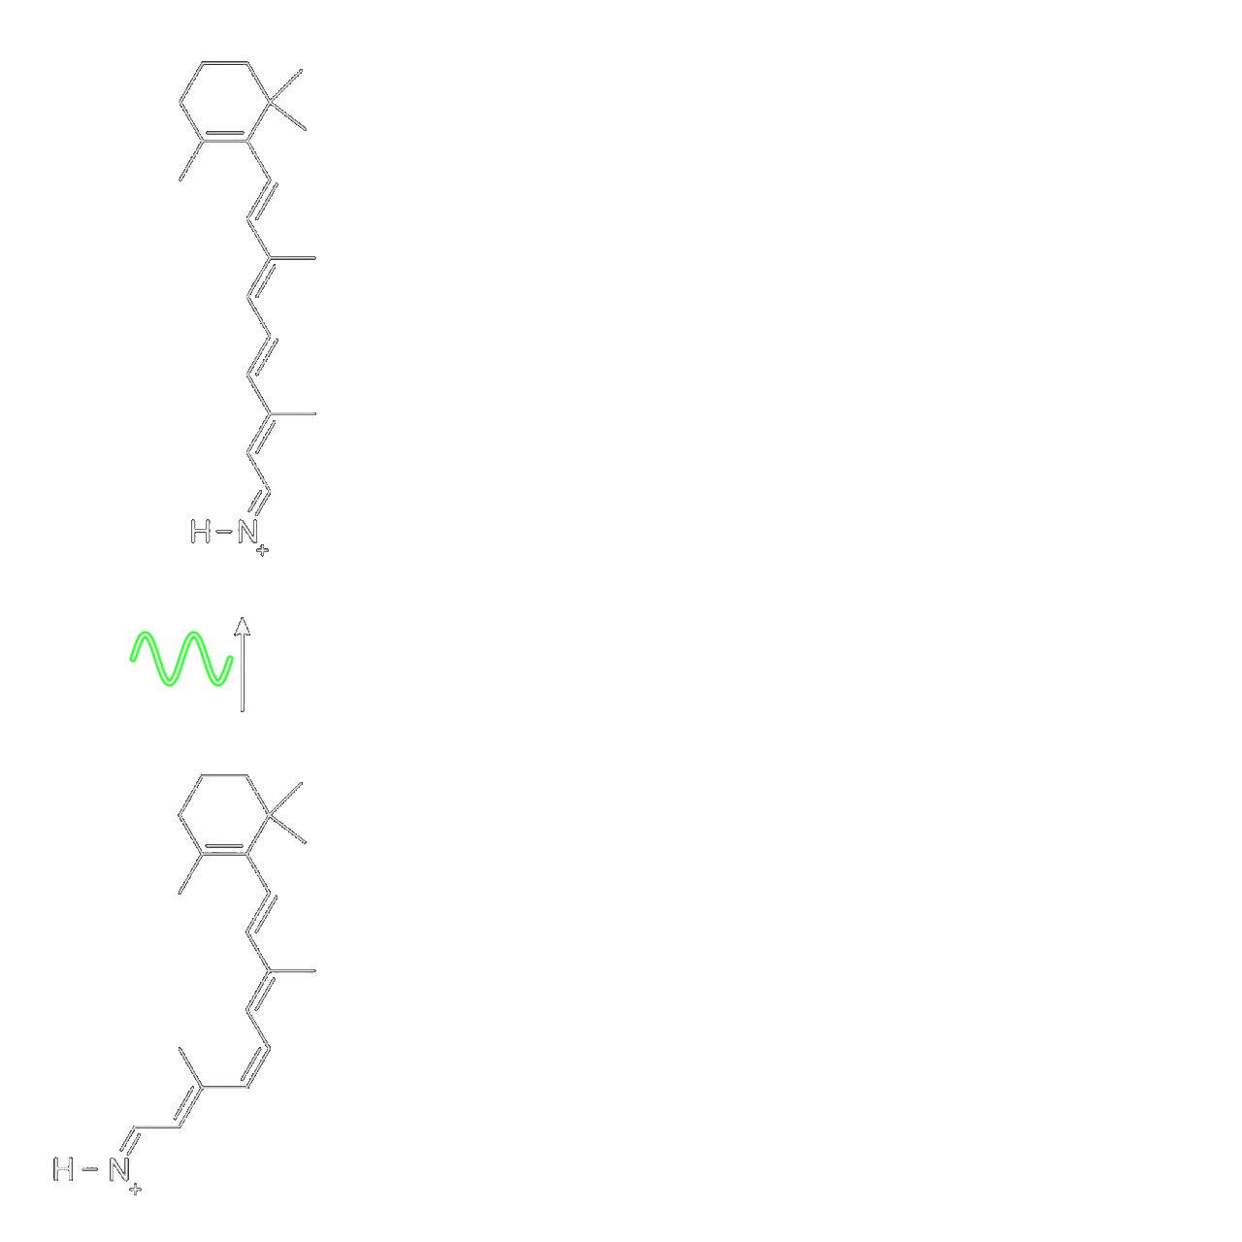
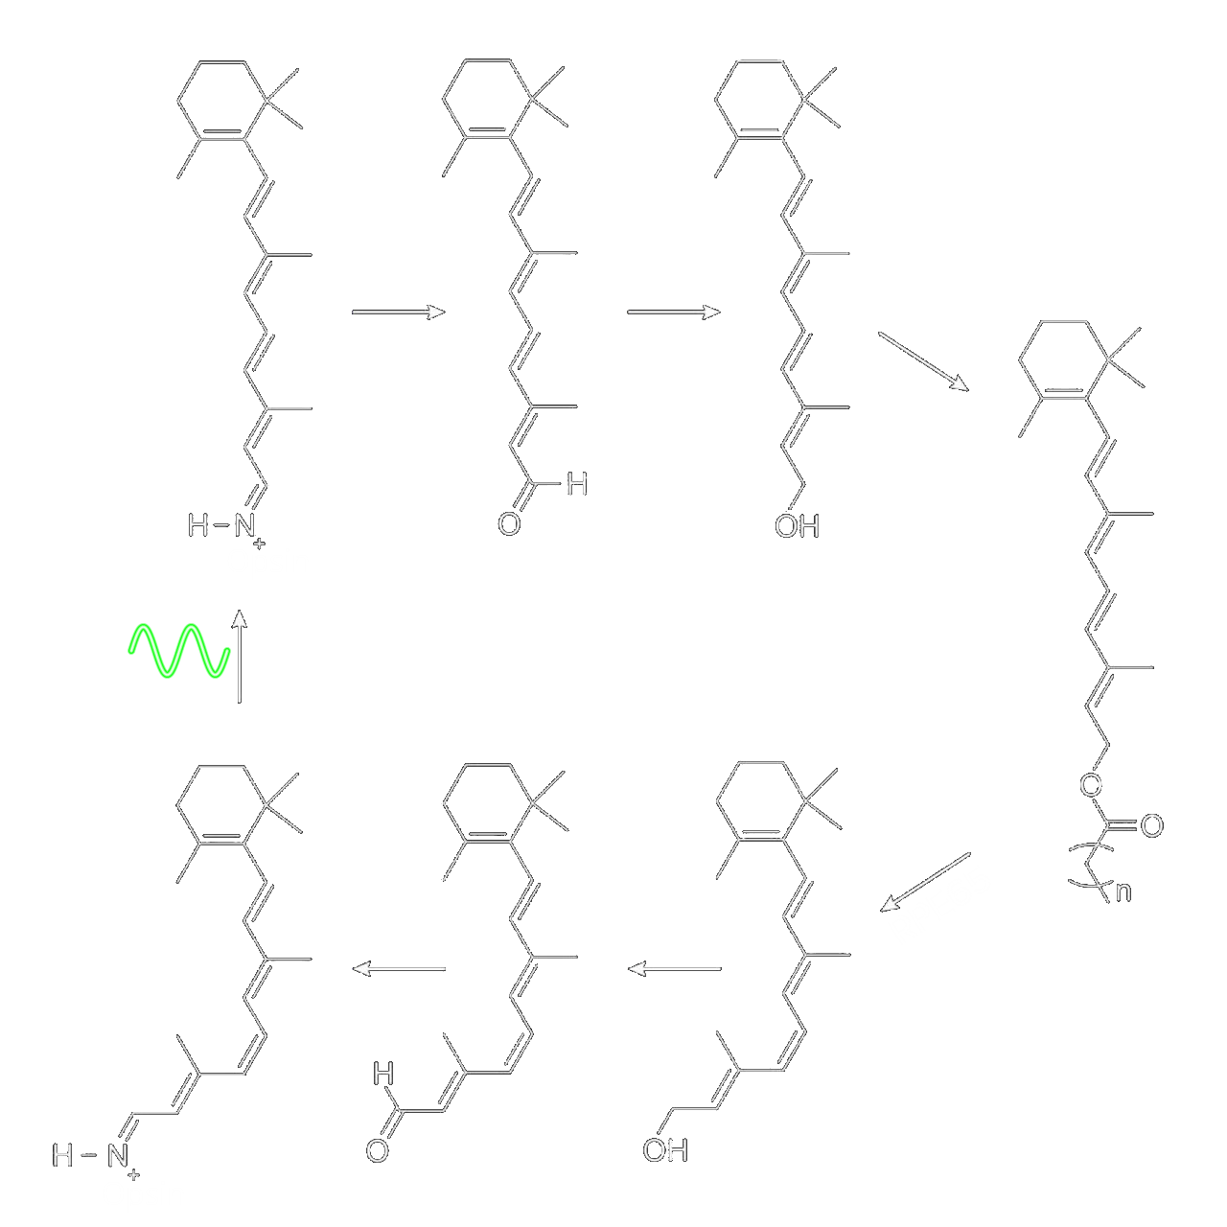
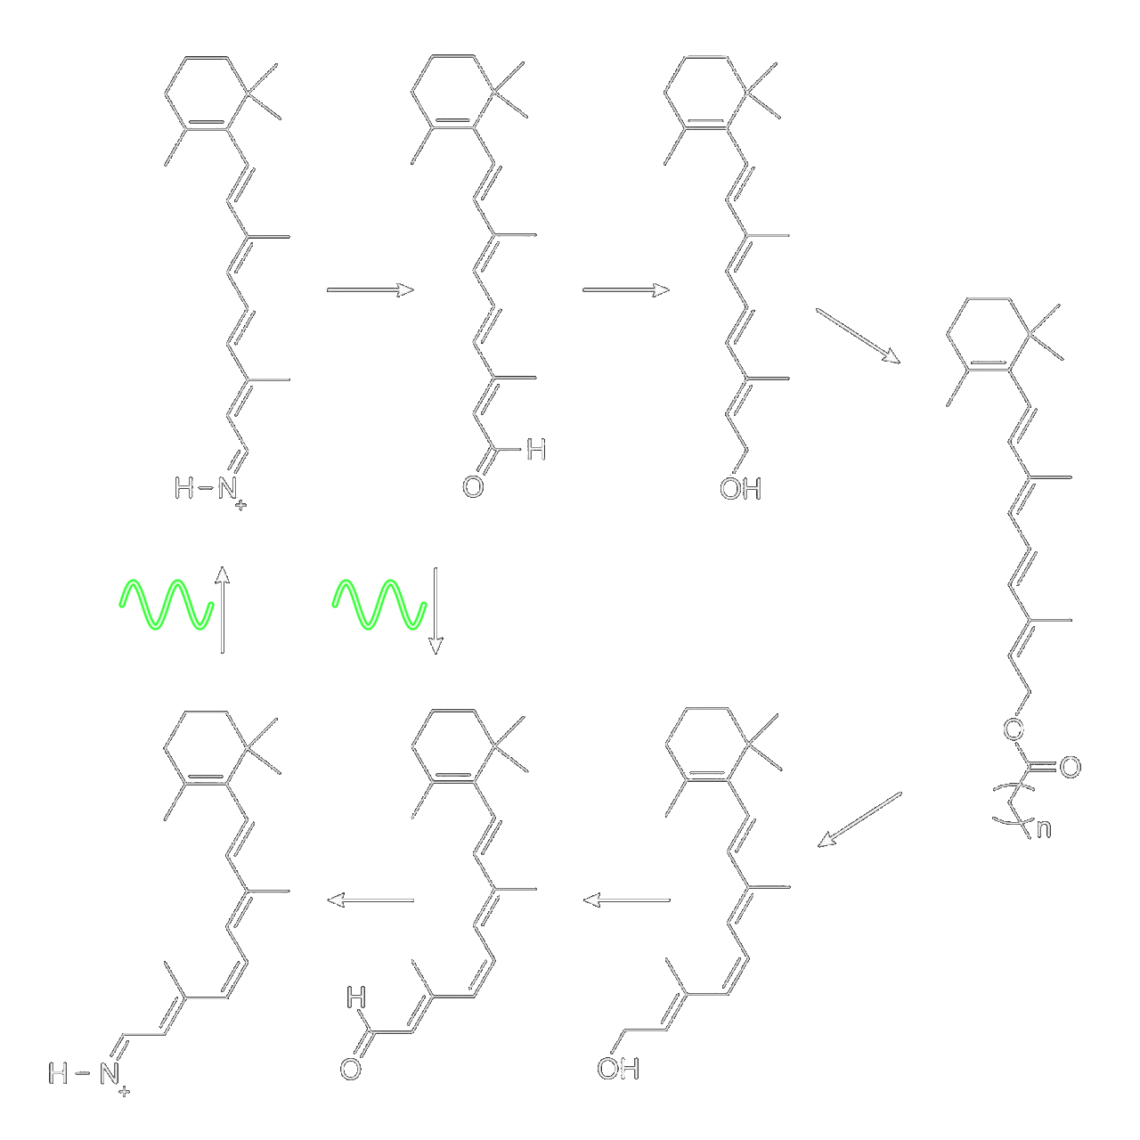
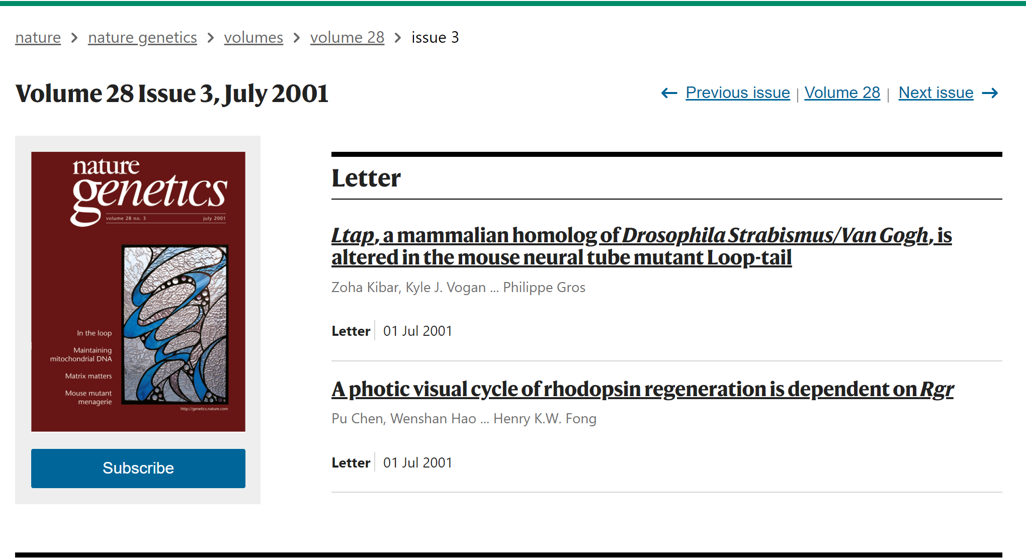
Aside: The Visual Cycle
Phototransduction (fast)
  Cascade of reactions producing neural signal
Visual cycle (slow)
  Regenerates chromophore
  Scotopic: requires no light
  Photic: complementary to phototransduction!

Slide 8
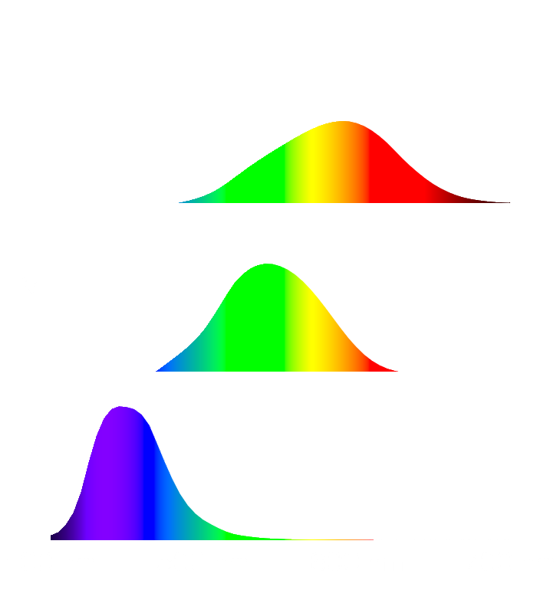
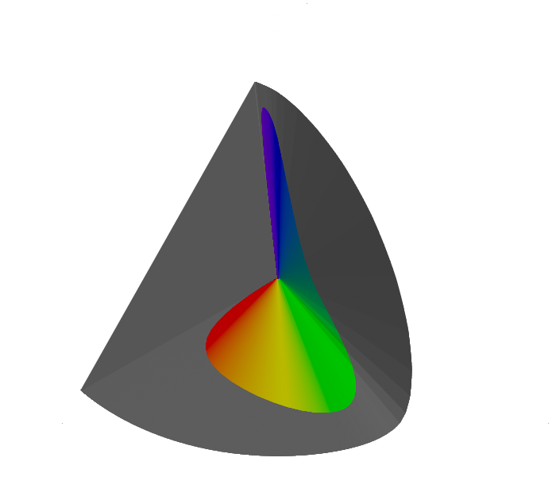
Biological Perception of Colour
Colour vision uses 3 types of cone receptor: L, M, S
Different opsins give different spectral responses
Every perceivable colour defined by
three tristimulus levels (L,M,S)
Every realizable colour lies inside
spectral cone (physical gamut)

Slide 9
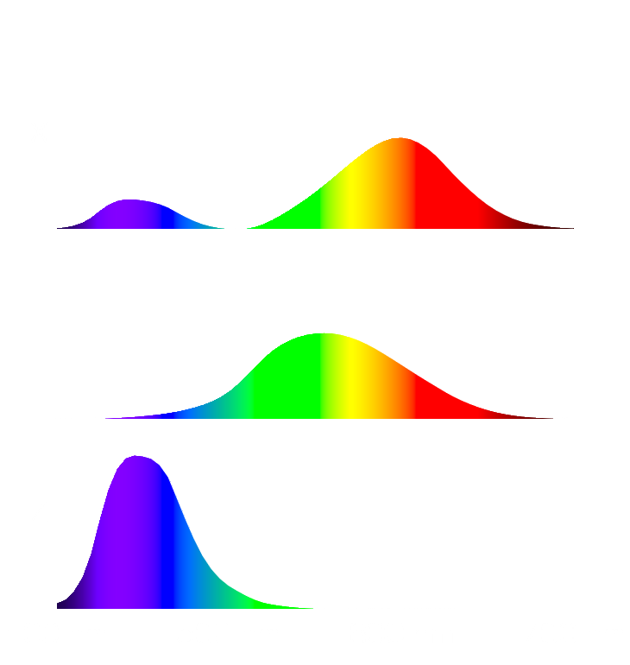
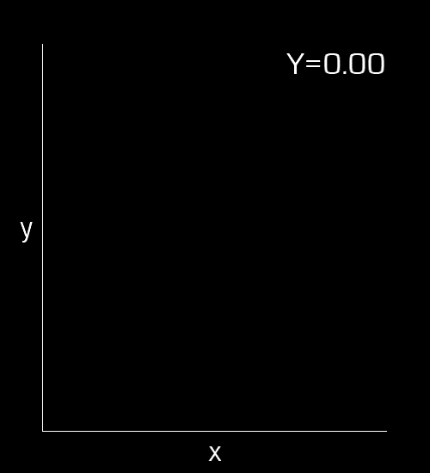
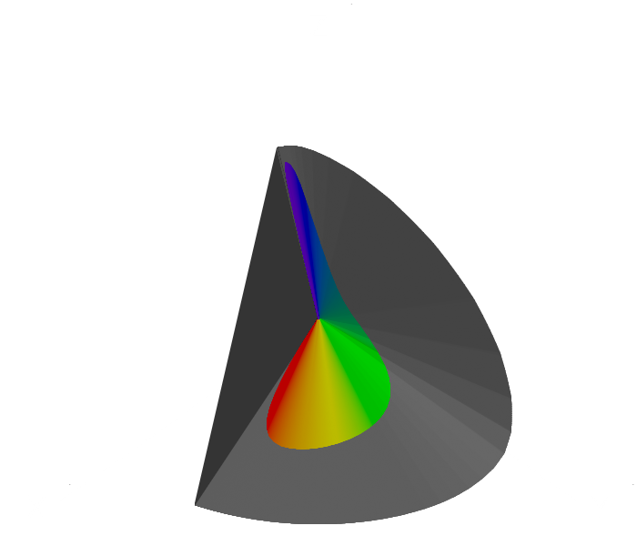
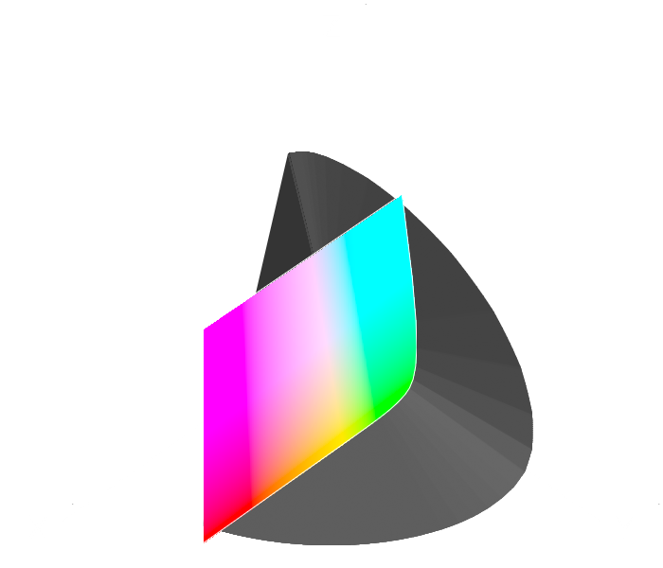
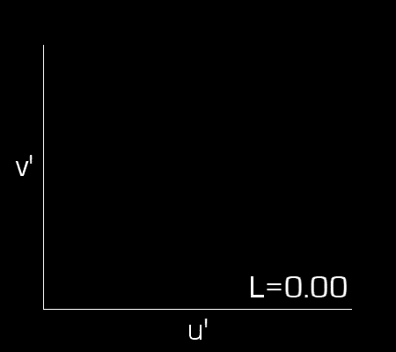
Representation of Colour
Commission Internationale de l'Éclairage (CIE) defines a standard XYZ space to represent any colour
Linear transform LMS ↔ XYZ
Y approximates overall perception
of luminance (colours with same Y
appear “equally bright”)
Luminance-chrominance spaces
defined from XYZ (e.g. xyY, Luv)

Slide 10
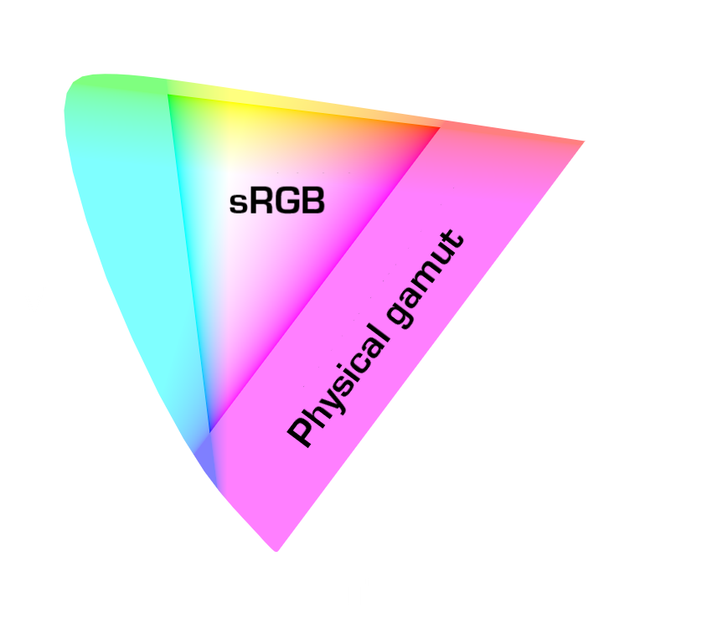
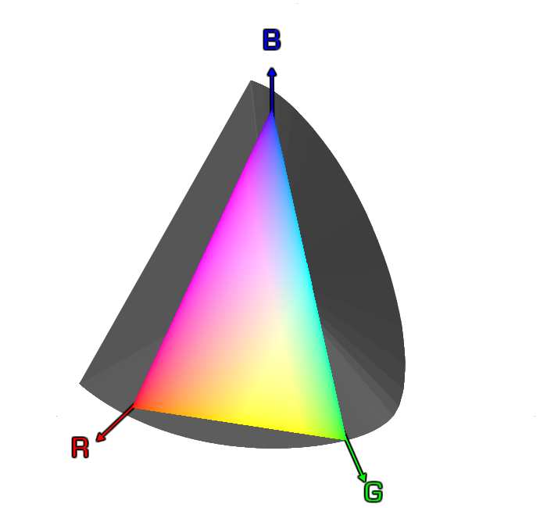
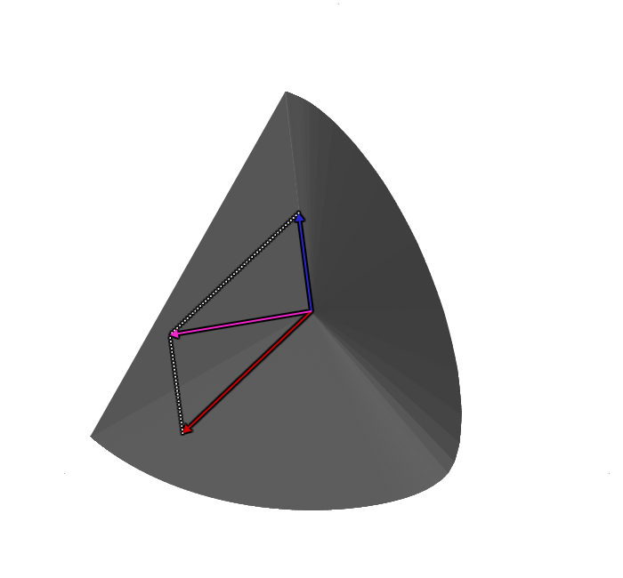
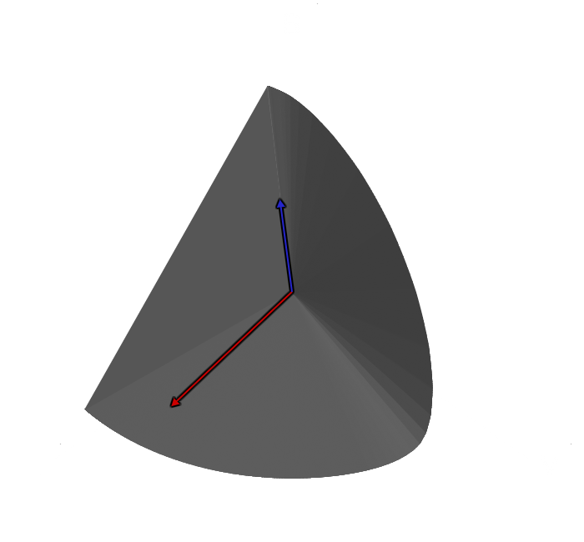
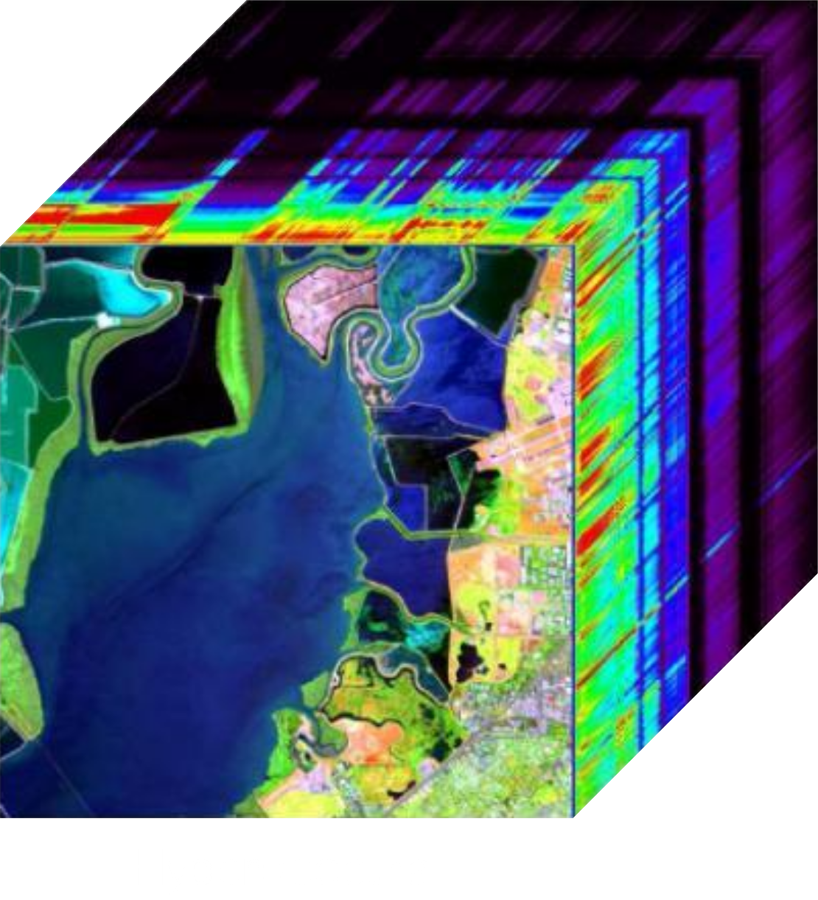
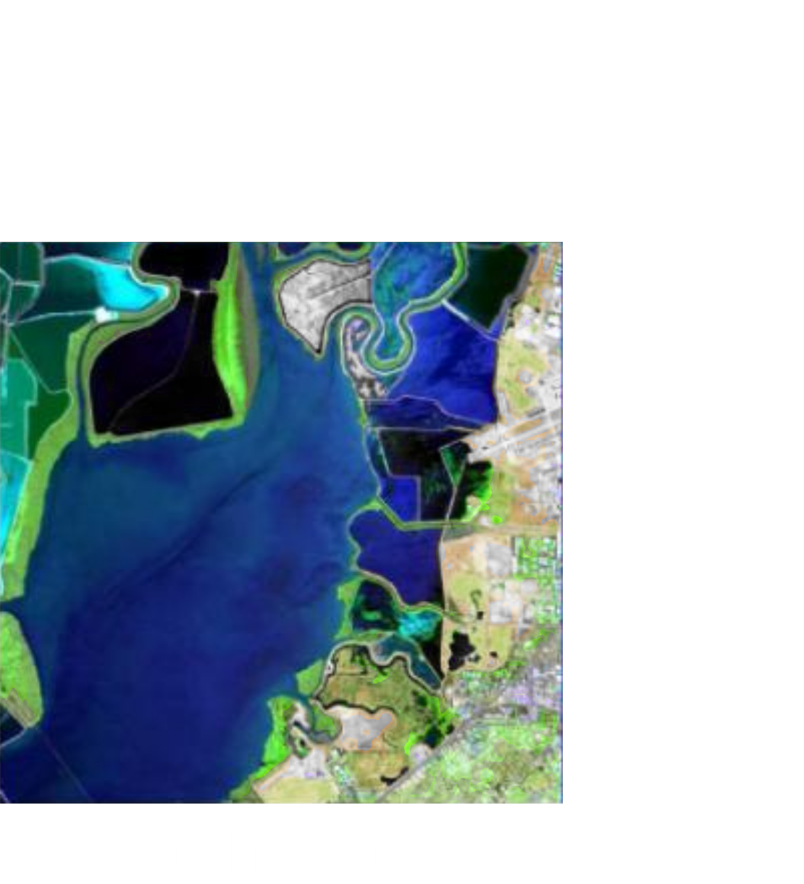
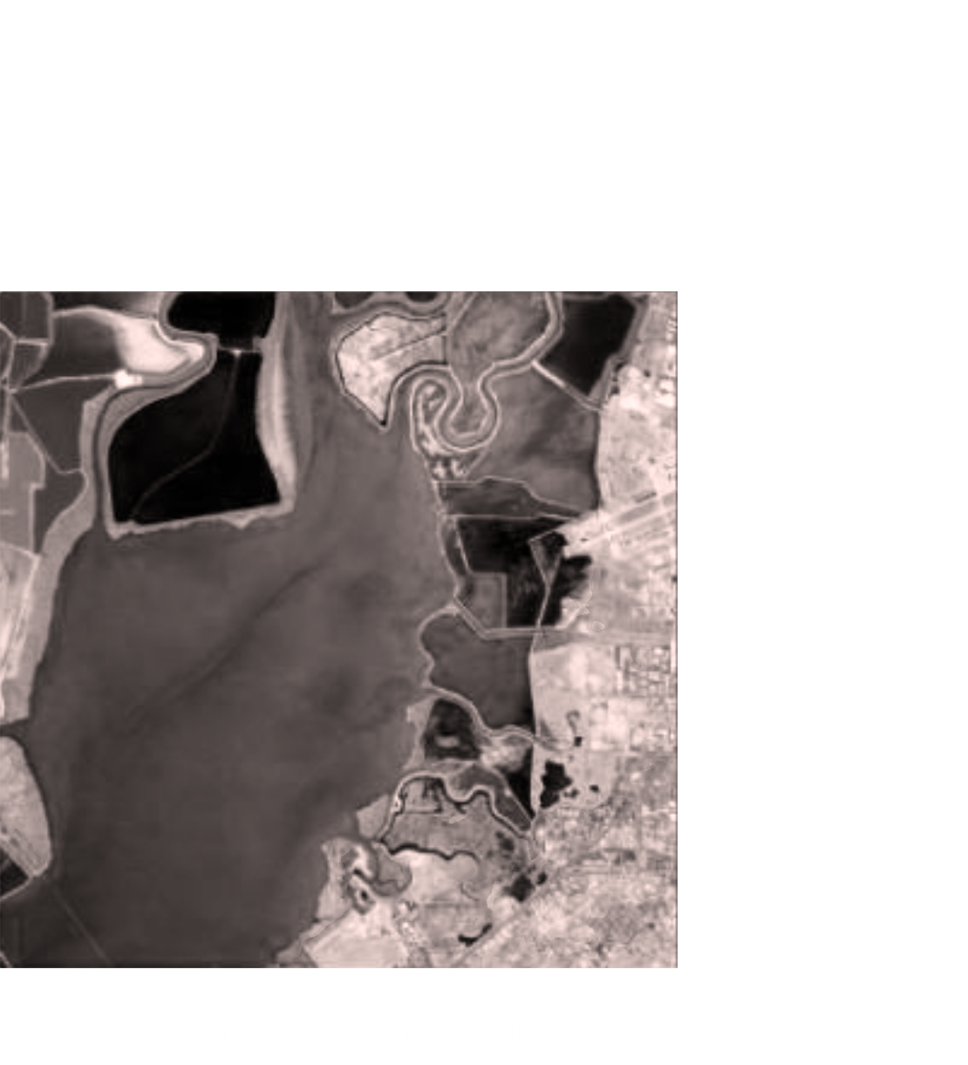
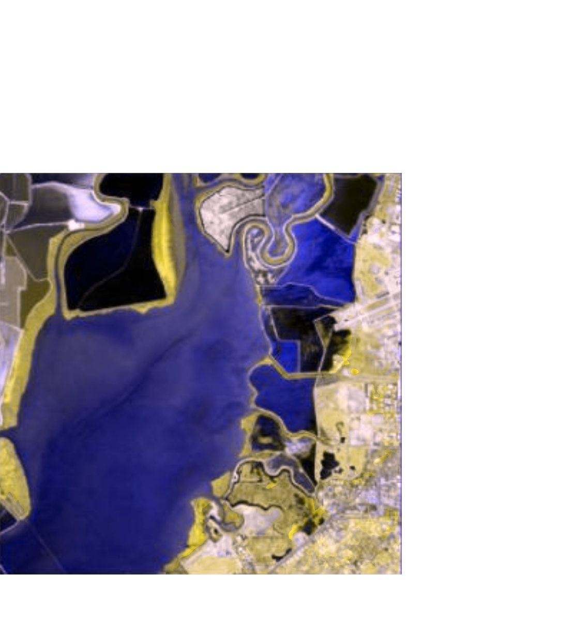
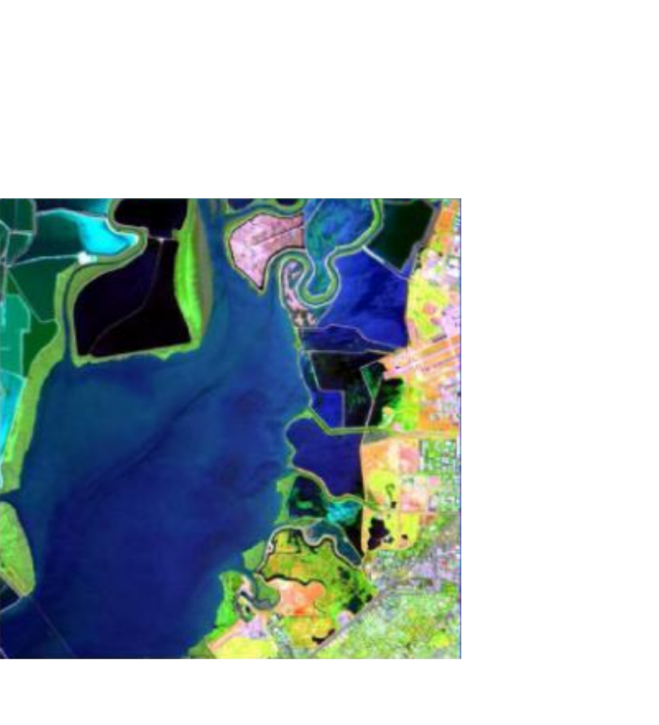
Colour Addition
When light sources combine, tristimulus levels add
3 suitable primary colours can span most of colour space
E.g. HDTV standard Red-Green-Blue
But some physical colours lie
outside any trichromatic gamut
Nonhumans (and some humans)
may have different dimensionality
colour spaces

Slide 11
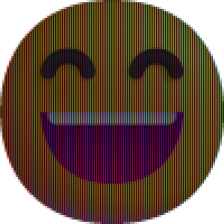




Colour Addition (cont’d)
How to combine colours additively:
  Projection
  Pixelation

Slide 12
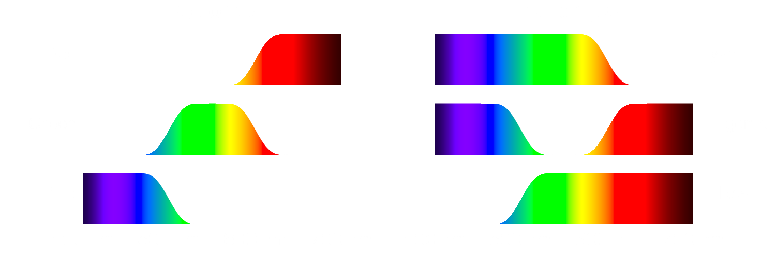
Colour Subtraction
Occurs when a material selectively absorbs or reflects light from a broad-spectrum source
  Technically the physical process is usually multiplicative
  Overall colour is the sum of the remaining colours
Subtractive primaries
are the complements
of additive primaries

Slide 13




Colour Subtraction (cont’d)
How to combine colours subtractively:
  Filters
  Pigments

Slide 14
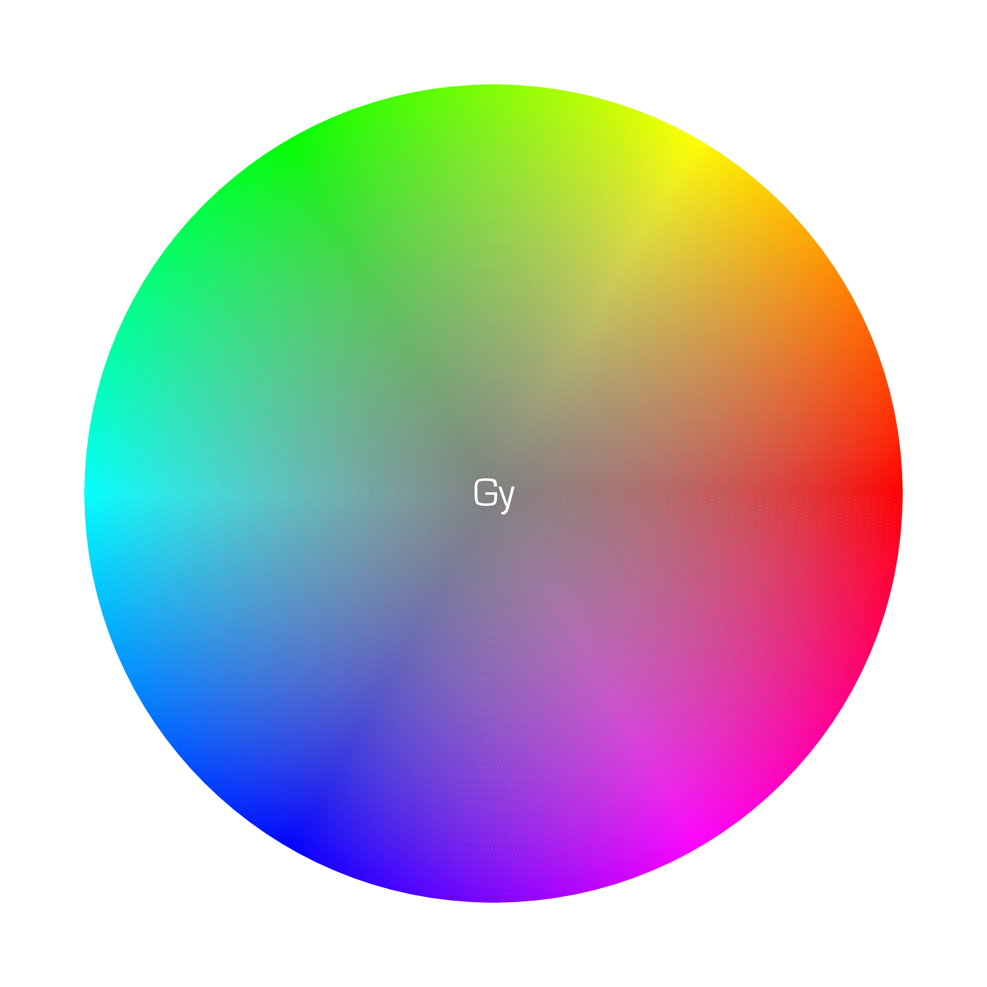
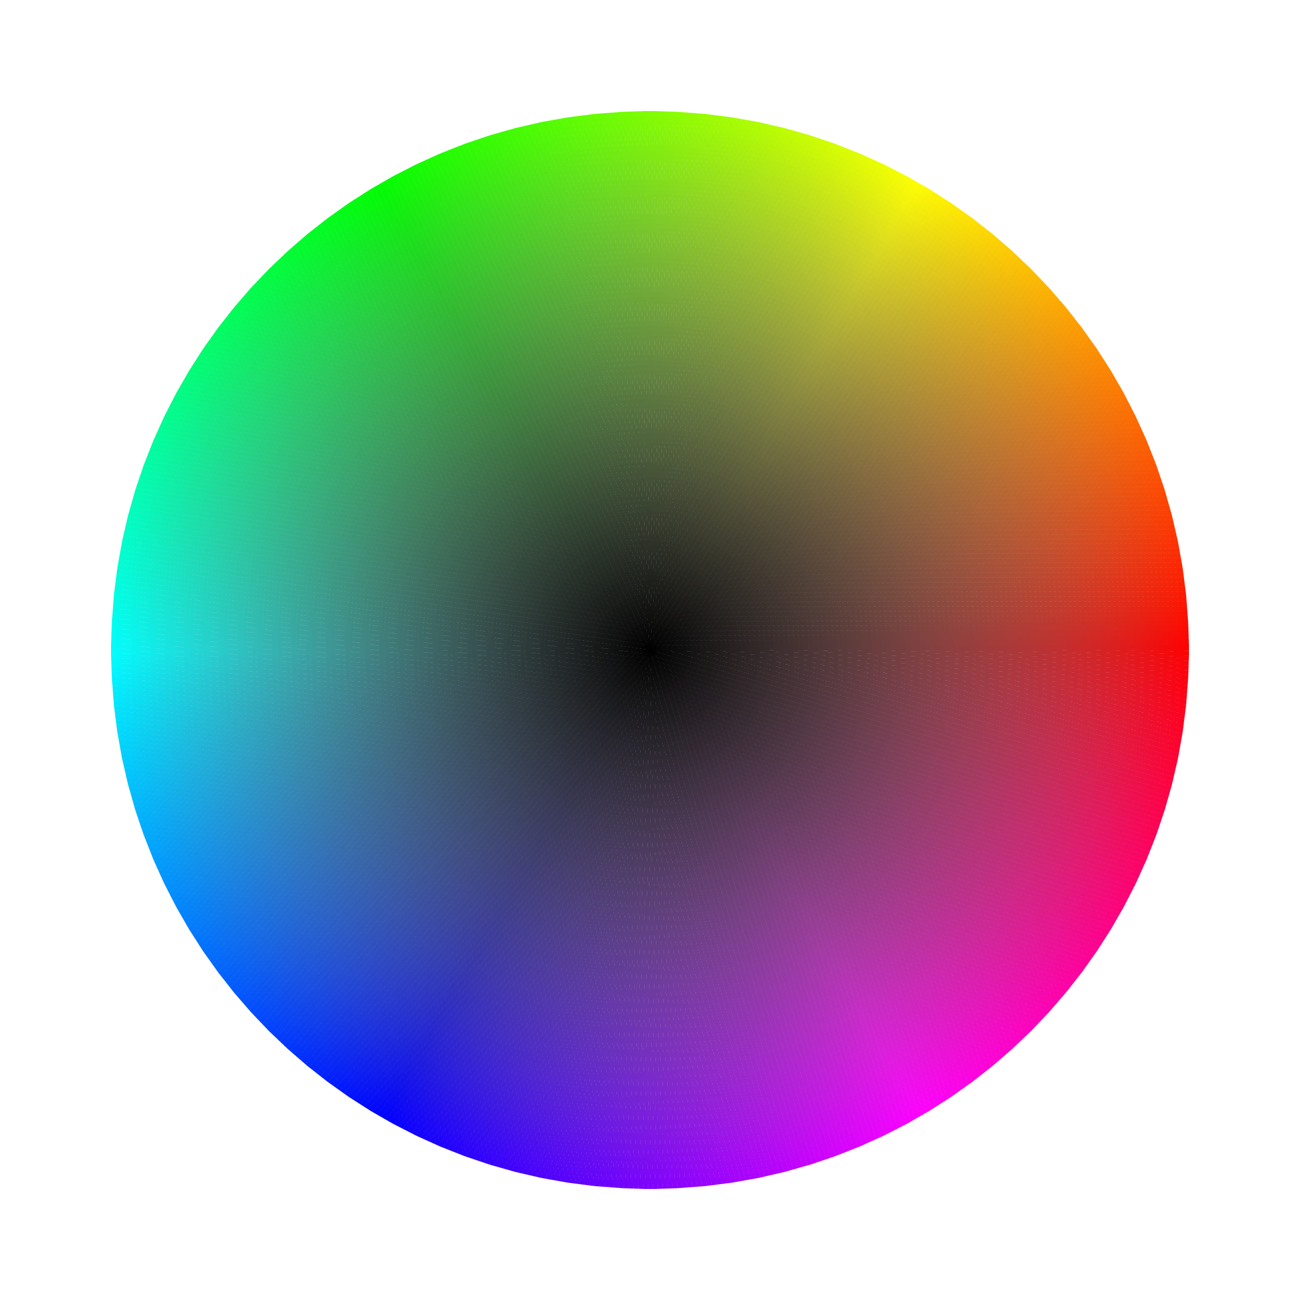
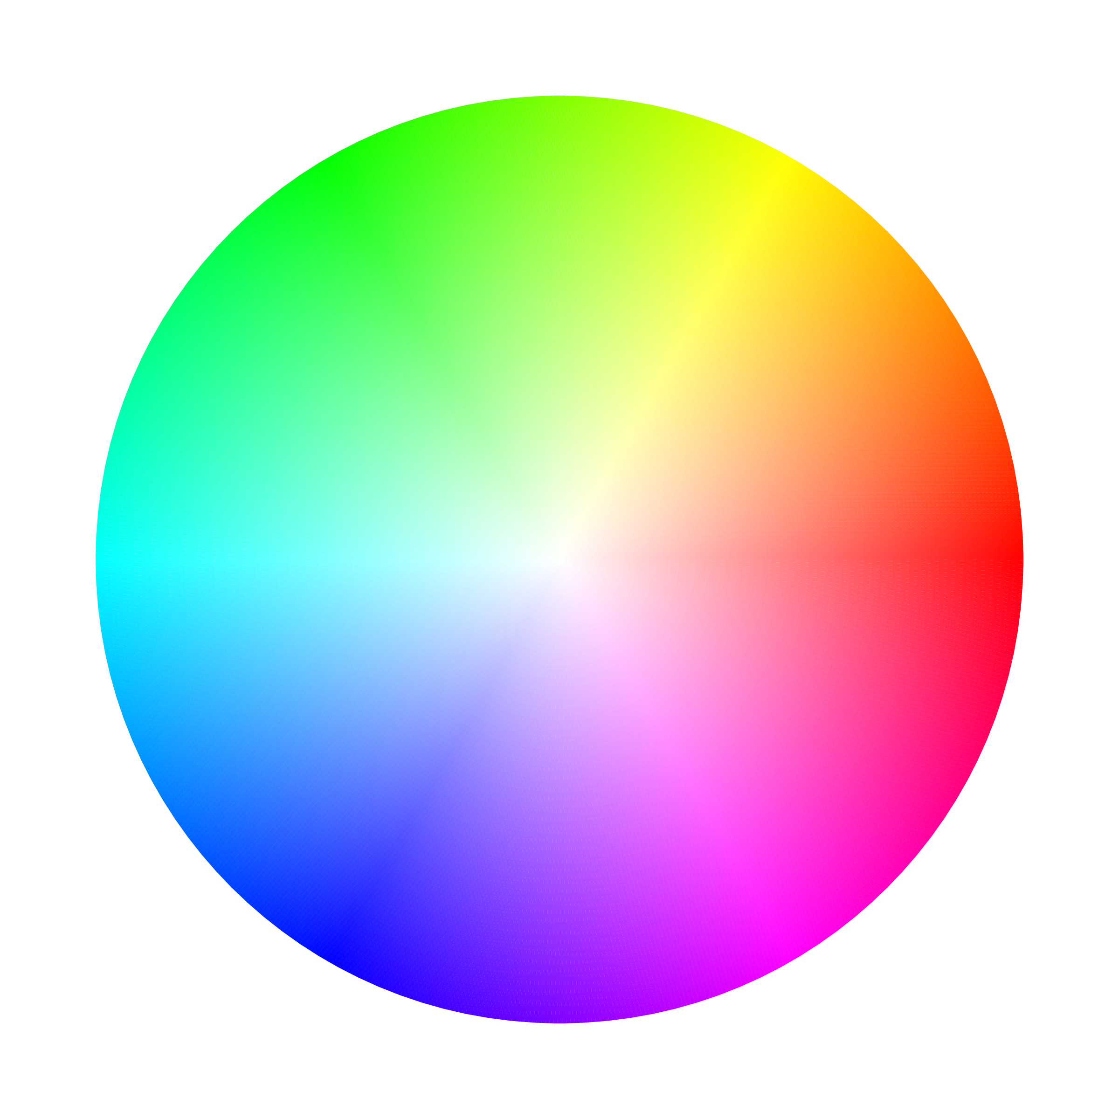
Summary
Human vision is trichromatic:
3 colour receptors → 3d colour space → 3 primary colours
Emitters combine
colours additively
Absorbers combine
colours subtractively
Physics, biochemistry, and
psychology affect perception!

Slide 15
Image Credits
Solar spectrum: SORCE
LED spectrum: DTU/Jost et al.
Eyeball: iStock/iZonda
Photoreceptors: Encyclopædia Britannica, Inc.
Rhodopsin, retinal: Wikipedia/Wikimedia
Visual cycle: JBC/Zhang et al.
Hyperspectral image: Wikimedia

Slide 16
Acknowledgements
Pu Chen
Special thanks to

