Slide 1
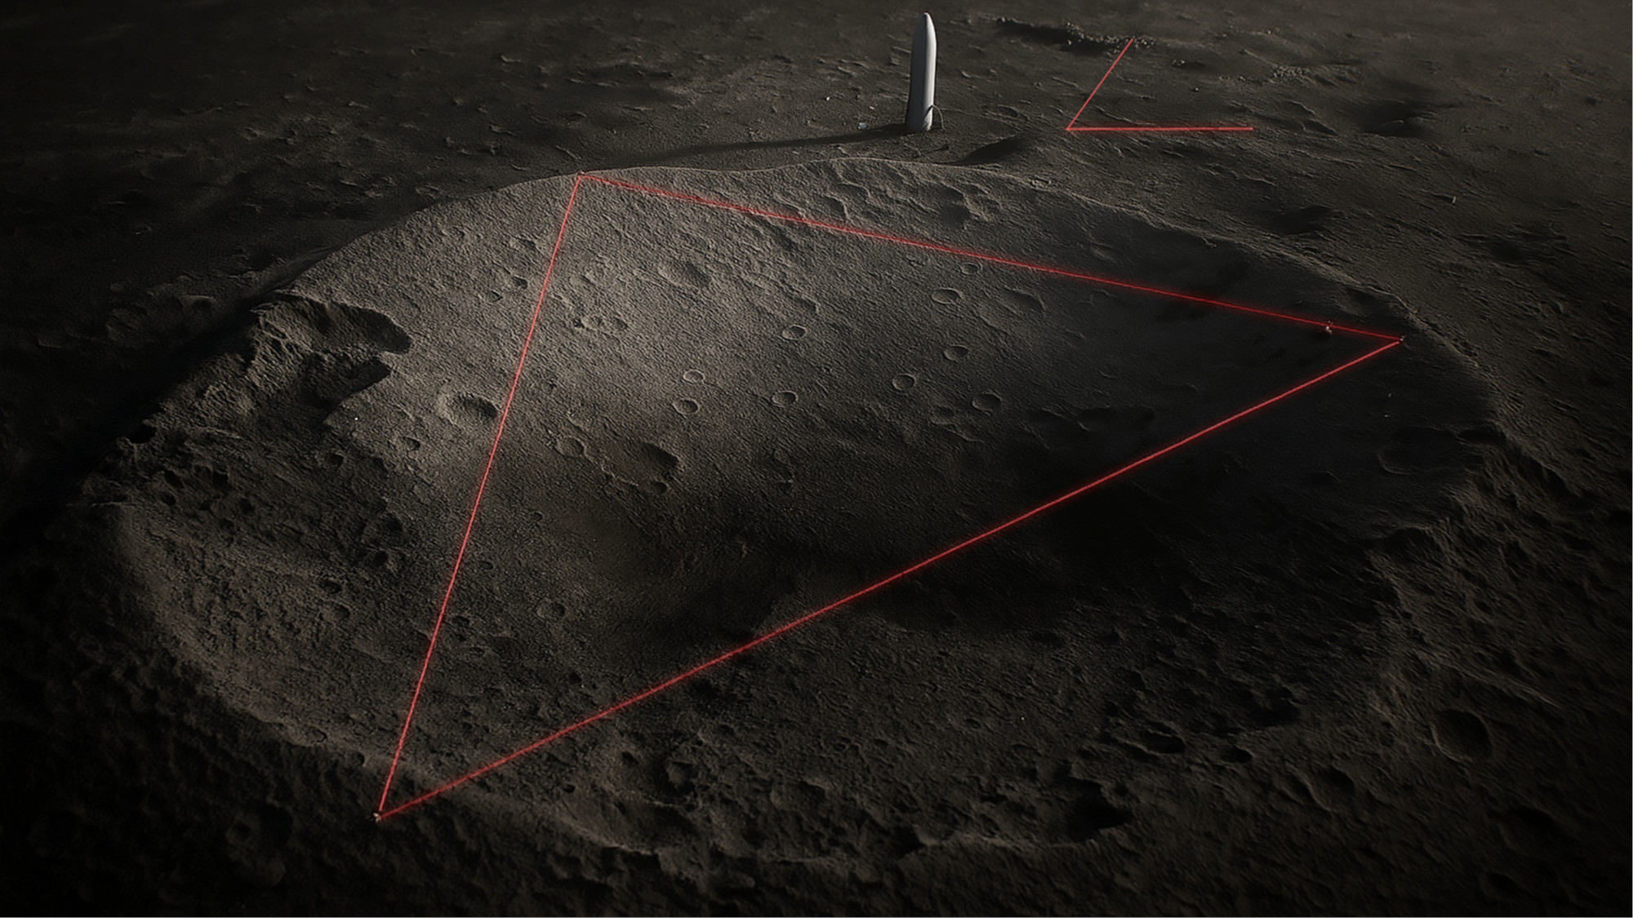

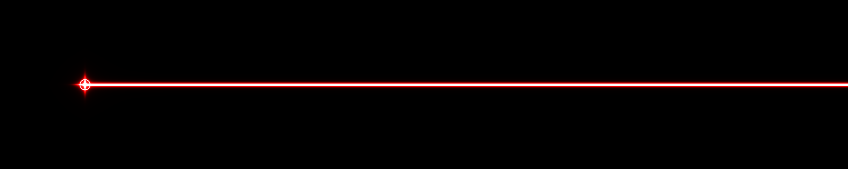


Laser Interferometer Lunar Antenna:
A Sub-Hz Gravitational-Wave Detector on the Moon
Teviet Creighton
for
John Conklin, Philippe Lognonné, Karan Jani,
Mark Panning, Volker Quetschke, Massimiliano Razzano,
Robert Reed, James Trippe

Slide 2
Outline
Science
Mission Concept and Design
Why the Moon?
  Natural advantages, challenges
  Leveraging the Lunar economy
LILA Collaboration

Slide 3
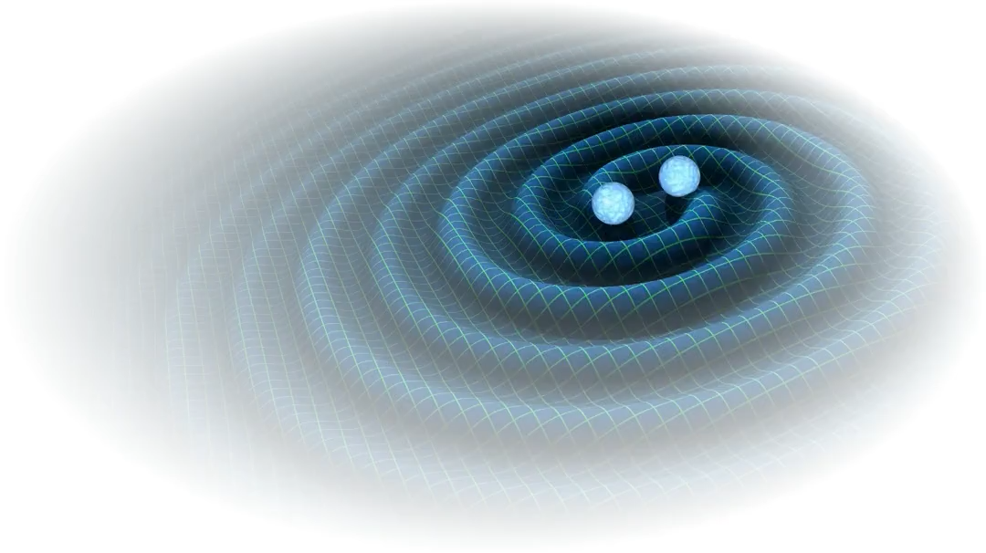
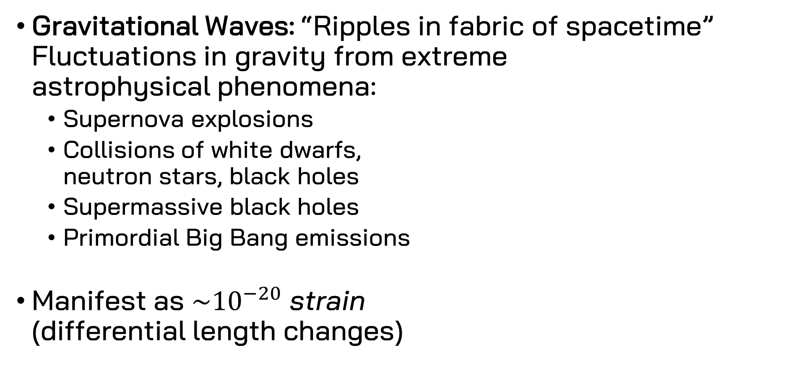
Science
Gravitational Waves: “Ripples in fabric of spacetime”
Fluctuations in gravity from extreme
astrophysical phenomena:
  Supernova explosions
  Collisions of white dwarfs,
  neutron stars, black holes
  Supermassive black holes
  Primordial Big Bang emissions
Manifest as $\sim {10}^{−20}$ strain
(differential length changes)

Slide 4
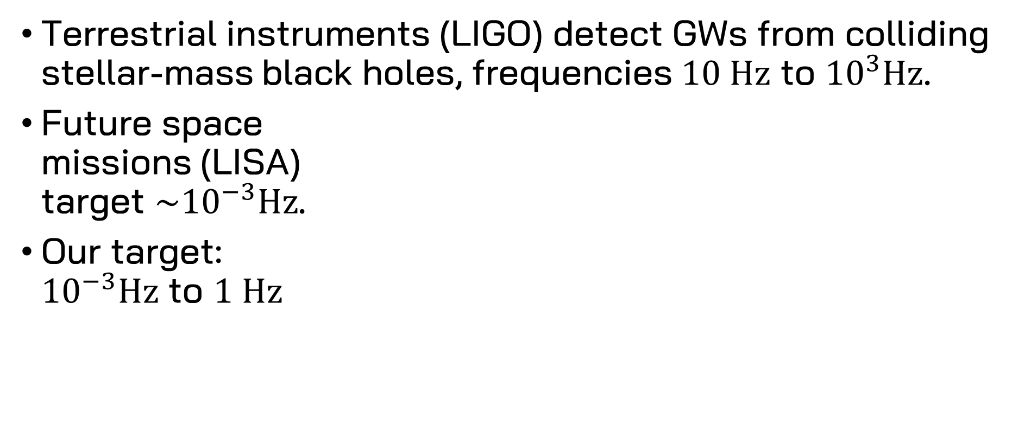
Science
Terrestrial instruments (LIGO) detect GWs from colliding stellar-mass black holes, frequencies $10 Hz$ to ${10}^{3}\text{Hz}$.
Future space
missions (LISA)
target $\sim {10}^{−3}\text{Hz}$.
Our target:
${10}^{−3}Hz$ to $1 \text{Hz}$

Slide 5
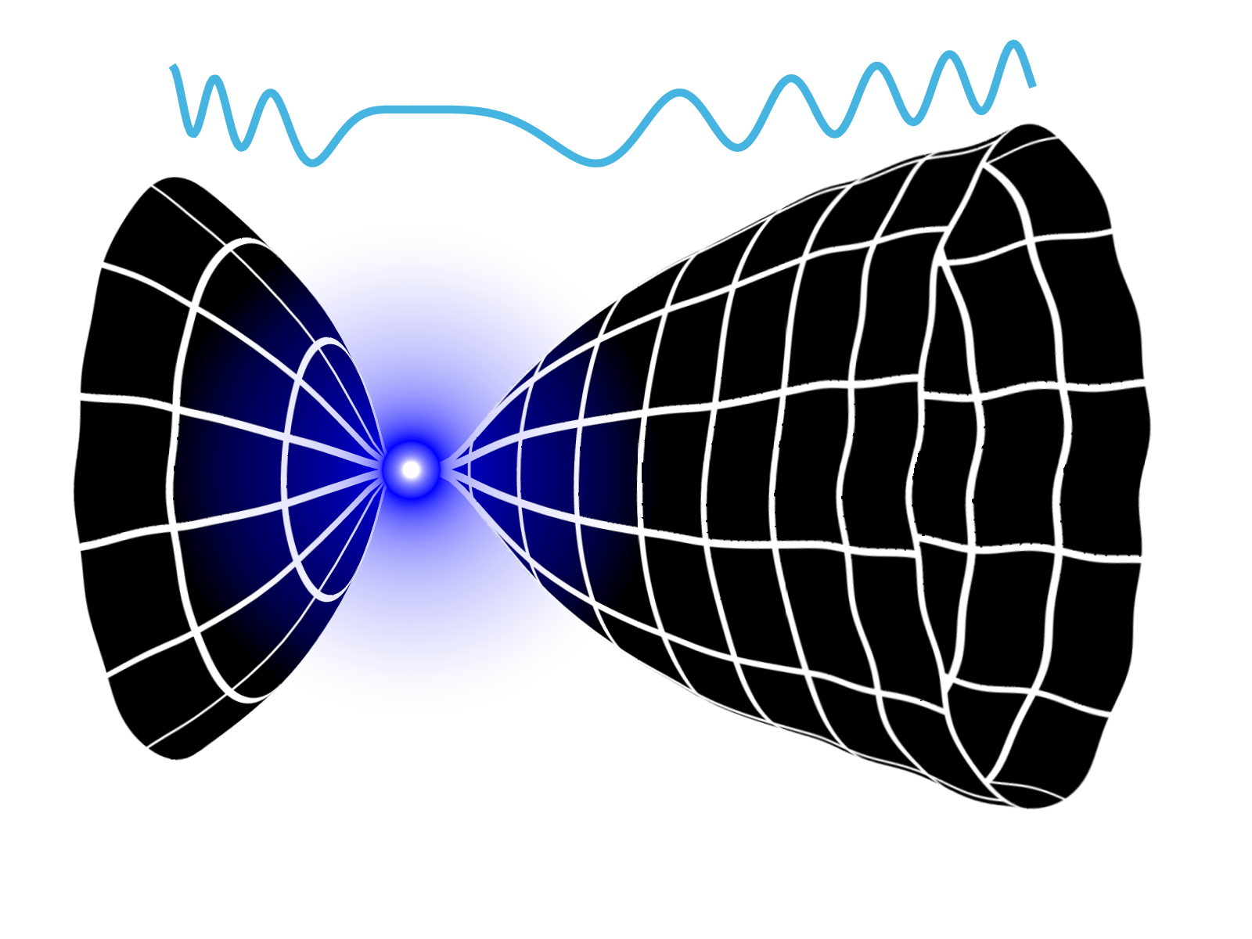
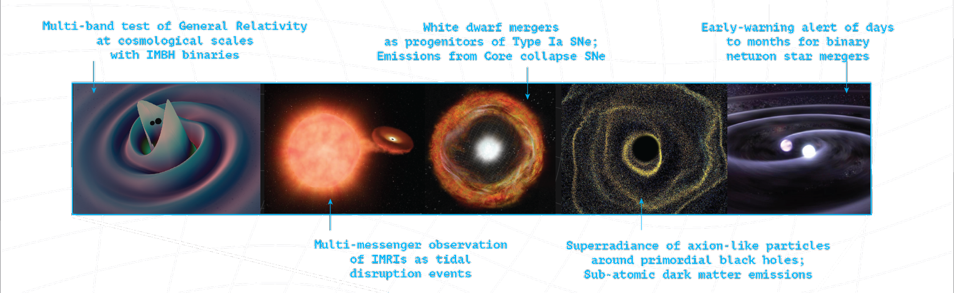
Science
Astrophysics Landscape
Primordial waves
emitted by Planck
era singularity

Slide 6
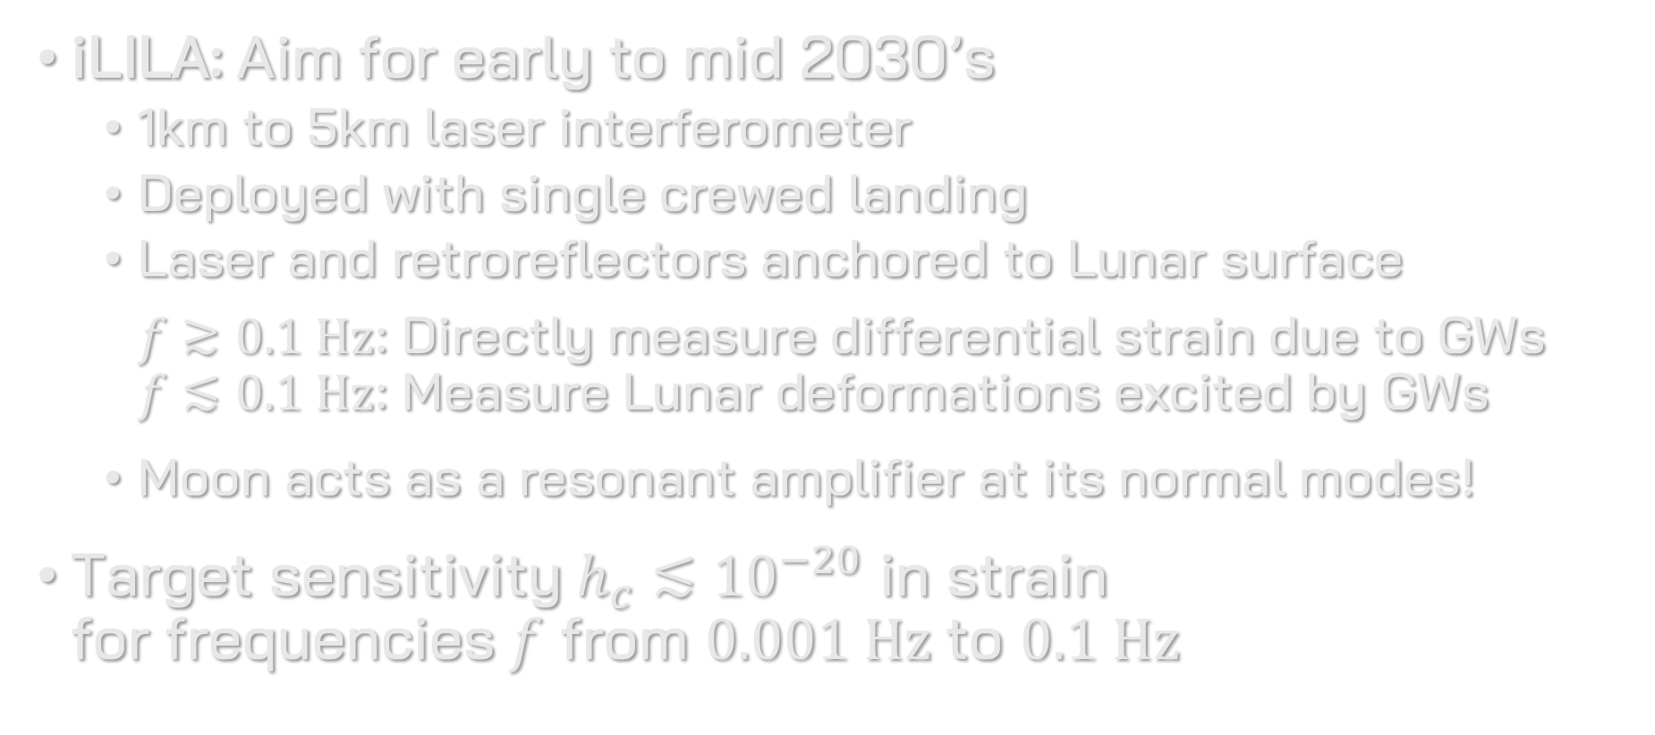
Mission Concept
iLILA: Aim for early to mid 2030’s
  1km to 5km laser interferometer
  Deployed with single crewed landing
  Laser and retroreflectors anchored to Lunar surface
  $f≳0.1 \text{Hz}$: Directly measure differential strain due to GWs
  $f≲0.1 \text{Hz}$: Measure Lunar deformations excited by GWs
  Moon acts as a resonant amplifier at its normal modes!
Target sensitivity $h_{c}≲{10}^{−20}$ in strain
for frequencies $f$ from $0.001 \text{Hz}$ to $0.1 \text{Hz}$

Slide 7
Mission Concept
LILA Obs: +10 yr
  40+ km laser triangular interferometer
  Deployed with multiple crewed landings

Slide 8
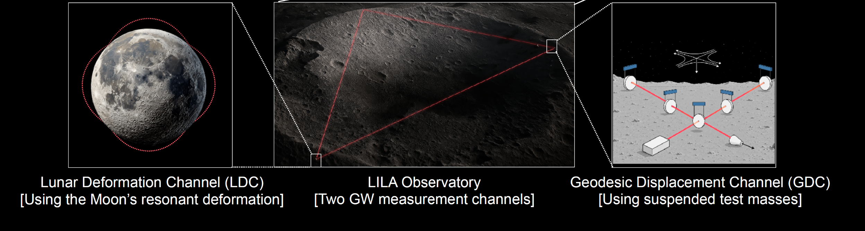
Mission Concept
LILA Obs: +10 yr
  40+ km laser triangular interferometer
  Deployed with multiple crewed landings
  “Xylophone” detector with two parallel interferometers:

Slide 9
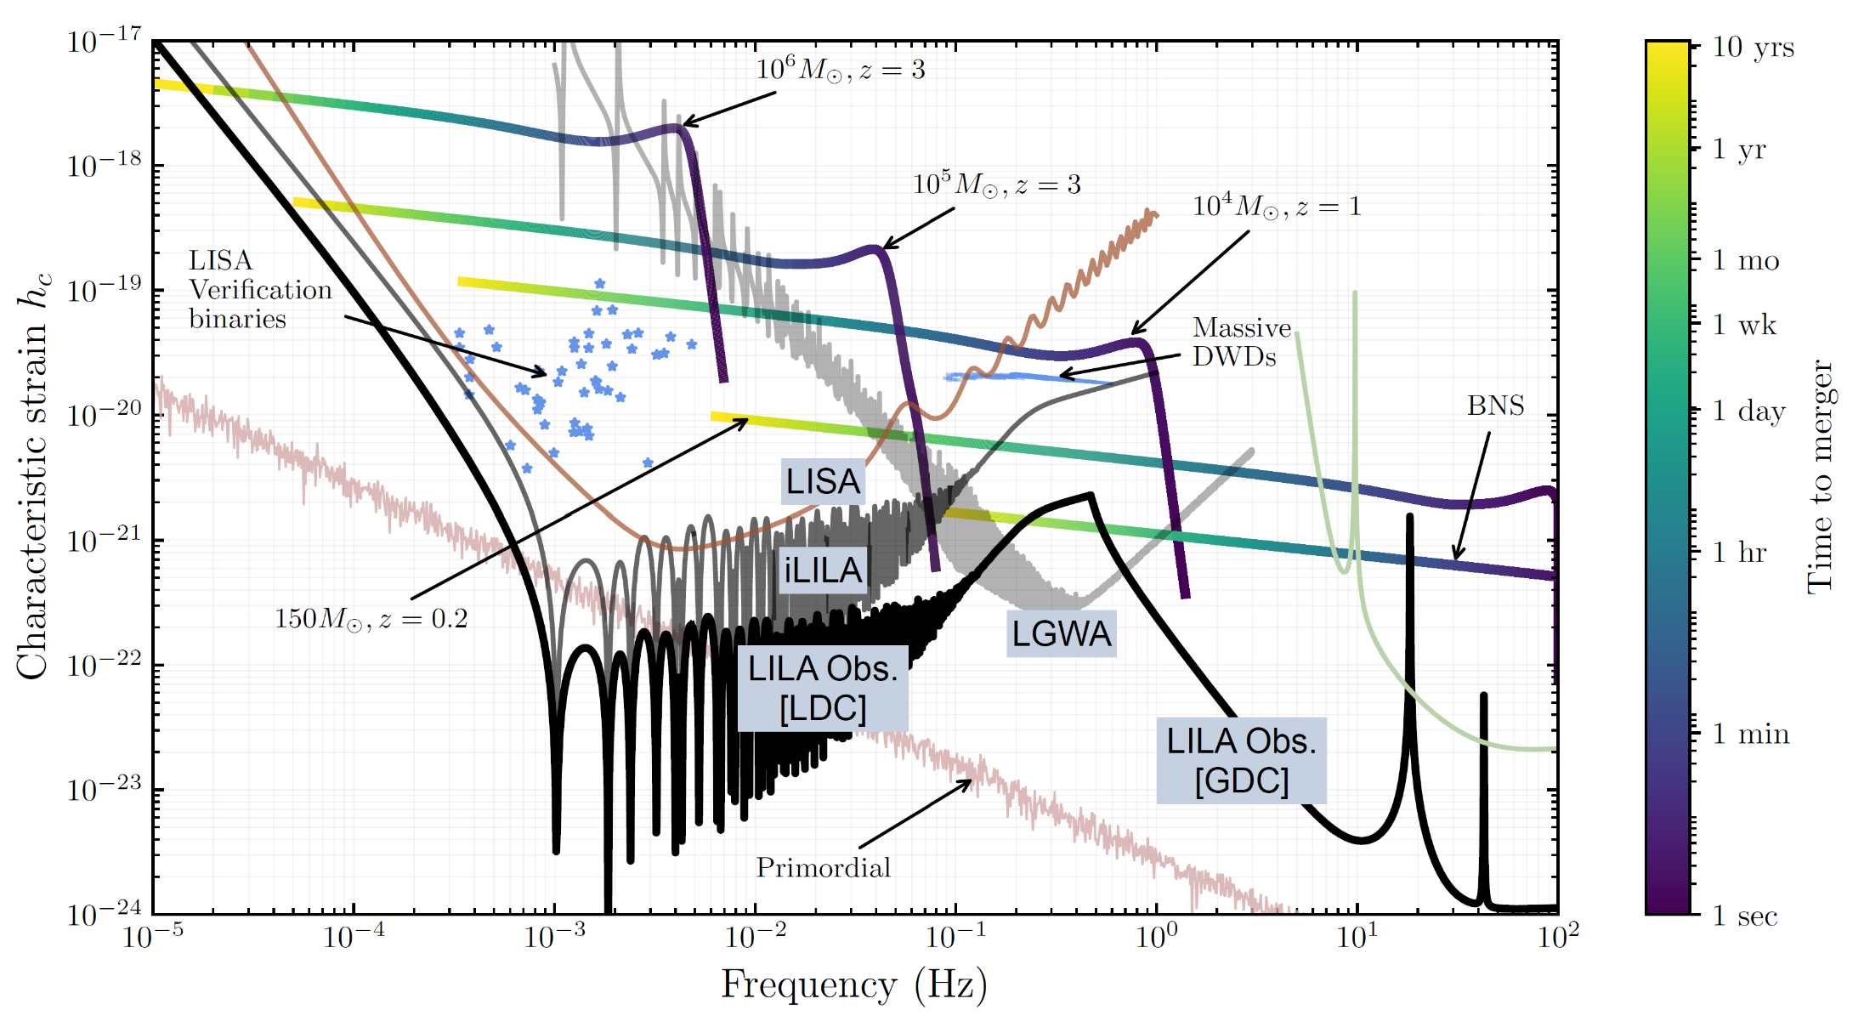
Mission Concept
T. Creighton, et. al, doi: 10.48550/arXiv.2508.18437.
M. Panning et. al, doi: 10.48550/arXiv.2509.15452.
J. Harms, doi: 10.1103/PhysRevLett.129.071102

Slide 10
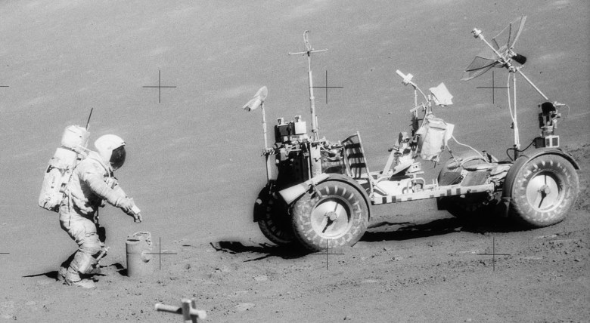
Why the Moon?
Natural advantages:
Seismically orders of magnitude quieter than Earth
(background below Apollo seismometer sensitivity)
Natural vacuum 100x better than GW detectors on Earth
No station-keeping
(compare to space antennas)

Slide 11
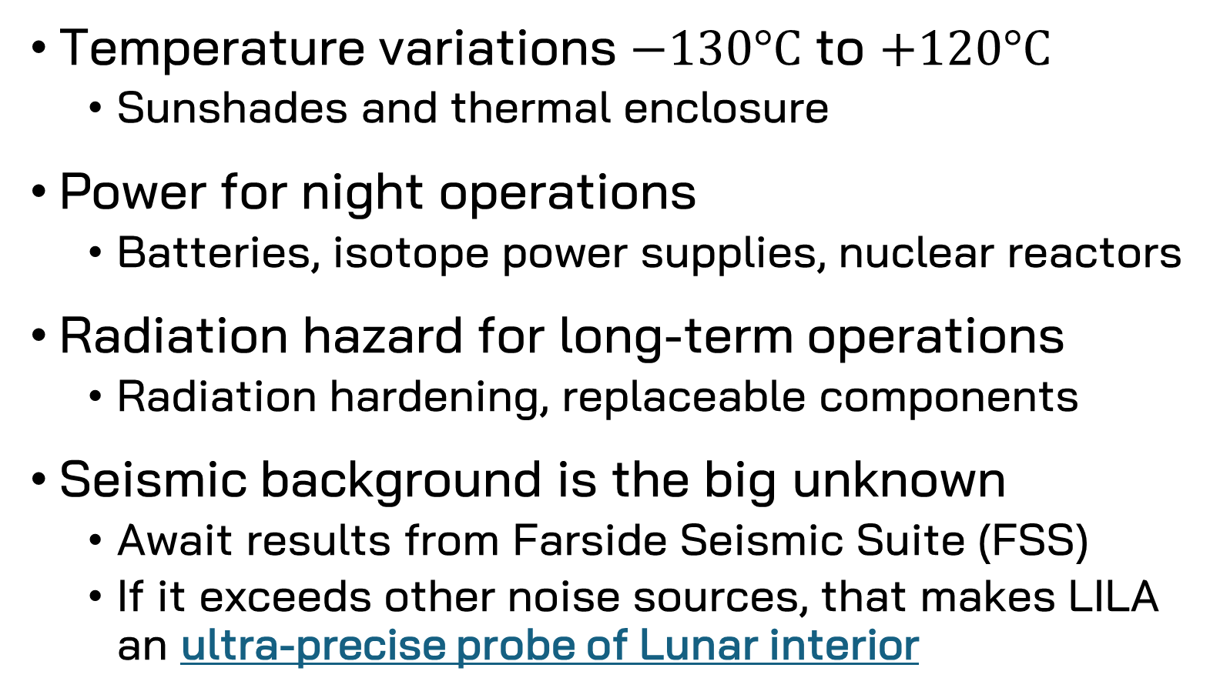
Why the Moon?
Challenges:
Temperature variations $−130°\text{C}$ to $+120°\text{C}$
  Sunshades and thermal enclosure
Power for night operations
  Batteries, isotope power supplies, nuclear reactors
Radiation hazard for long-term operations
  Radiation hardening, replaceable components
Seismic background is the big unknown
  Await results from Farside Seismic Suite (FSS)
  If it exceeds other noise sources, that makes LILA
  an ultra-precise probe of Lunar interior
?

Slide 12
Why the Moon?
Leveraging the Lunar Economy:
Employs humans for deployment and commissioning
Modular design allows for human servicing and repair
Comms, power, etc. benefit from other Lunar infrastructure and R&D
Concept is site-agnostic:
  Benefits from human presence for deployment, servicing
  (but not too close!)
  Does not tie up prime Lunar real estate

Slide 13


LILA Collaboration

Slide 14
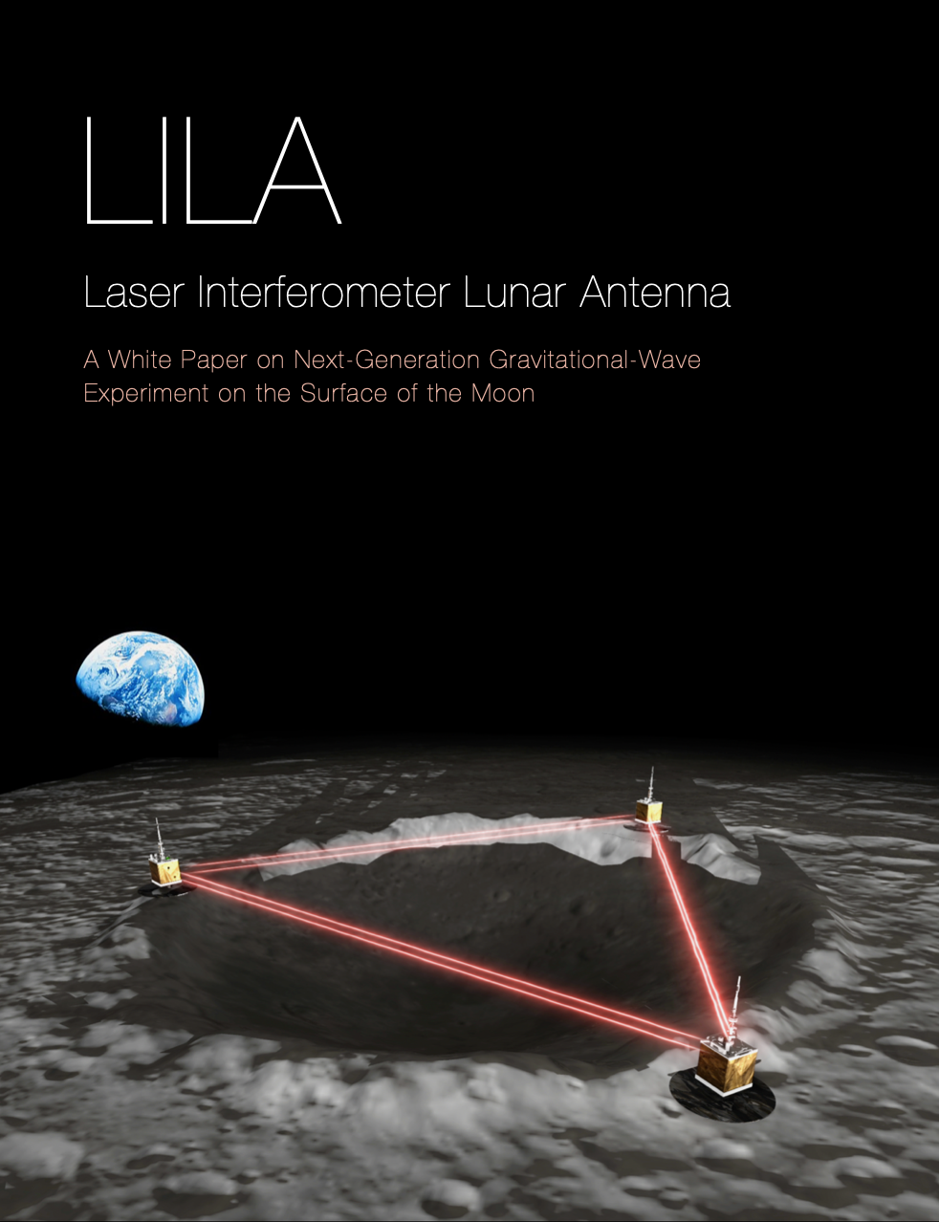
LILA Collaboration
A new discovery class mission
for astrophysics and geoscience
Learn more:
vanderbilt.edu/lunarlabs
Reach out:
lunarlabs@vanderbilt.edu
CQG Focus Edition on Lunar GW:
https://iopscience.iop.org/
collections/cqg-250609-856

Slide 15
Thank you!

Slide 16
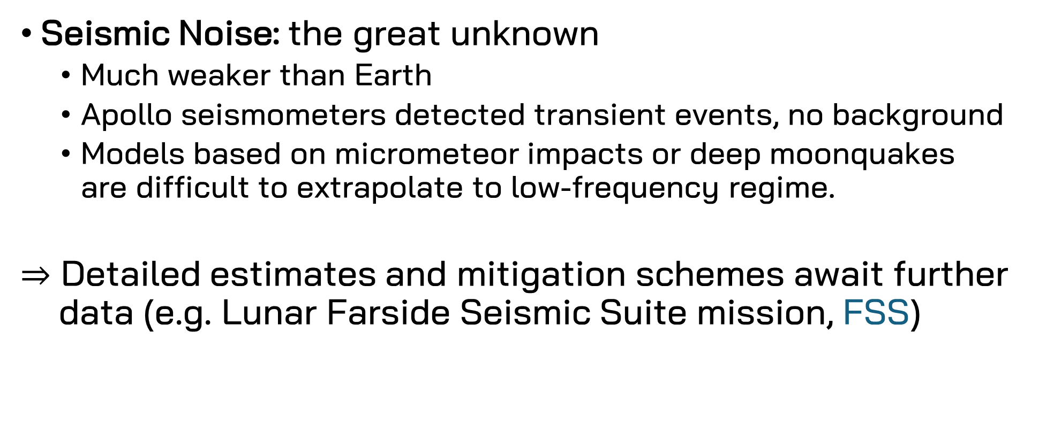
Fundamental Noise Sources
Seismic Noise: the great unknown
  Much weaker than Earth
  Apollo seismometers detected transient events, no background
  Models based on micrometeor impacts or deep moonquakes are difficult to extrapolate to low-frequency regime.
$⇒$ Detailed estimates and mitigation schemes await further
data (e.g. Lunar Farside Seismic Suite mission, FSS)

Slide 17
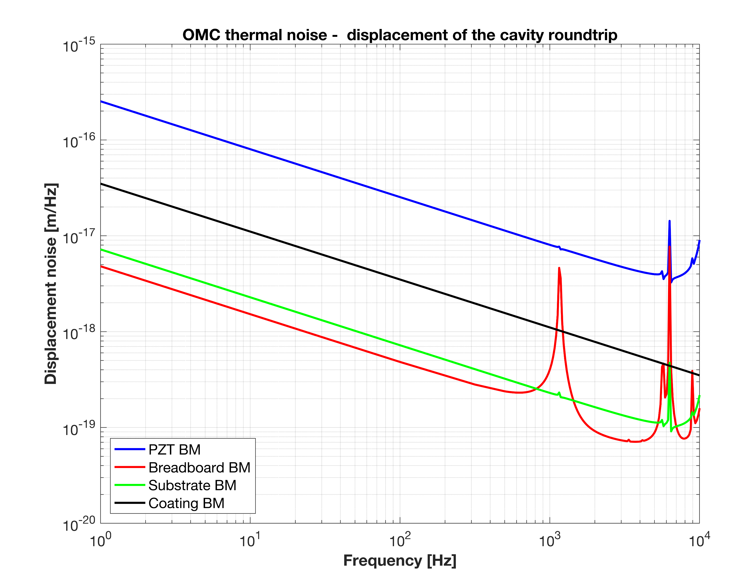
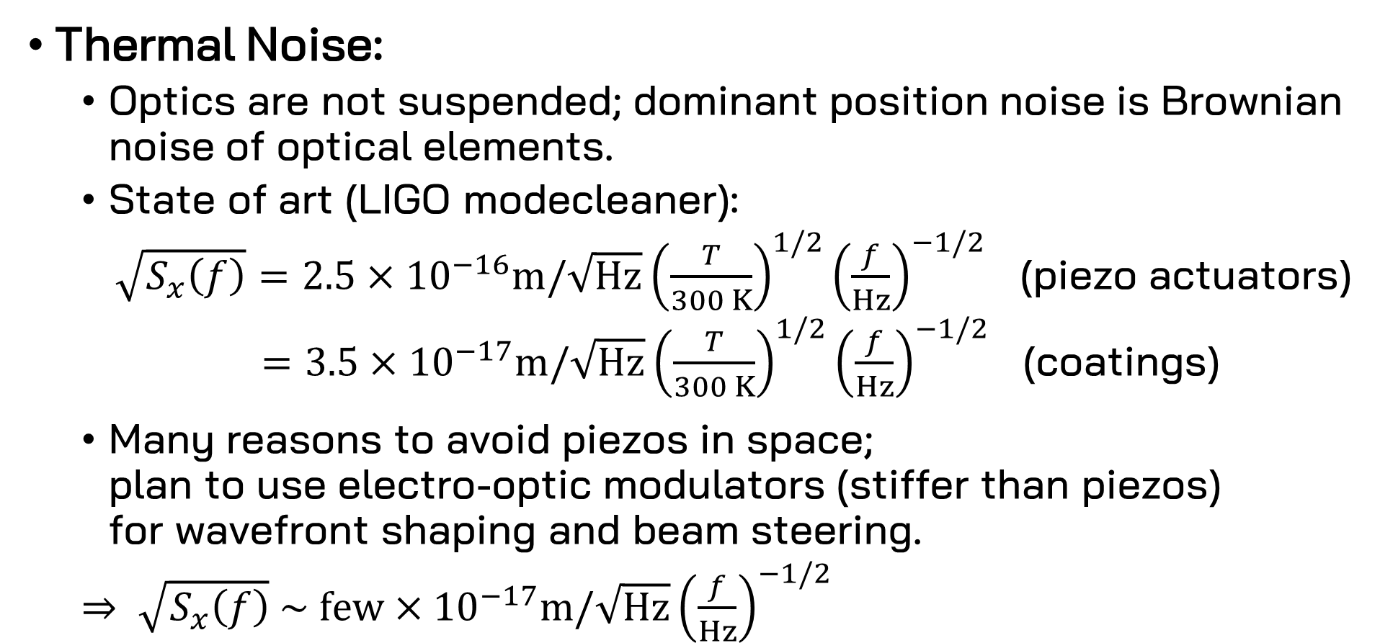
Fundamental Noise Sources
Thermal Noise:
  Optics are not suspended; dominant position noise is Brownian noise of optical elements.
  State of art (LIGO modecleaner):
  $\sqrt{S_{x}\left(f\right)}=2.5×{10}^{−16}m/\sqrt{Hz}{\left(\frac{T}{300 K}\right)}^{1/2}{\left(\frac{f}{Hz}\right)}^{−1/2}$ (piezo actuators)
  $=3.5×{10}^{−17}m/\sqrt{Hz}{\left(\frac{T}{300 K}\right)}^{1/2}{\left(\frac{f}{Hz}\right)}^{−1/2}$ (coatings)
  Many reasons to avoid piezos in space;
  plan to use electro-optic modulators (stiffer than piezos)
  for wavefront shaping and beam steering.
  $⇒ \sqrt{S_{x}\left(f\right)} \sim few×{10}^{−17}m/\sqrt{Hz}{\left(\frac{f}{Hz}\right)}^{−1/2}$
Koji Arai, LIGO-G1800149

Slide 18
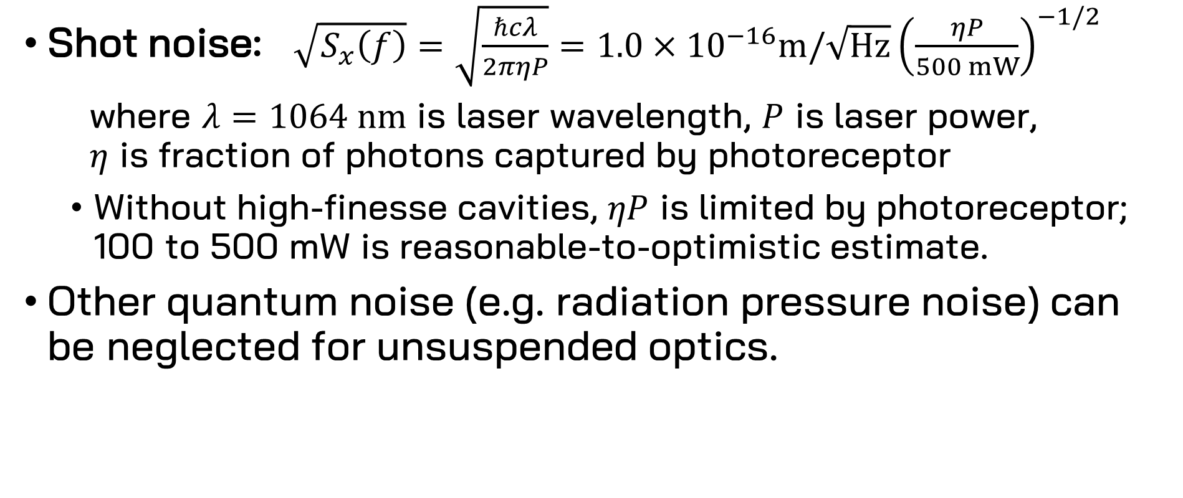
Fundamental Noise Sources
Shot noise: $\sqrt{S_{x}\left(f\right)}=\sqrt{\frac{ℏcλ}{2πηP}}=1.0×{10}^{−16}m/\sqrt{Hz}{\left(\frac{ηP}{500 mW}\right)}^{−1/2}$
  where $λ=1064 nm$ is laser wavelength, $P$ is laser power,
  $η$ is fraction of photons captured by photoreceptor
  Without high-finesse cavities, $ηP$ is limited by photoreceptor; 100 to 500 mW is reasonable-to-optimistic estimate.
Other quantum noise (e.g. radiation pressure noise) can be neglected for unsuspended optics.

Slide 19
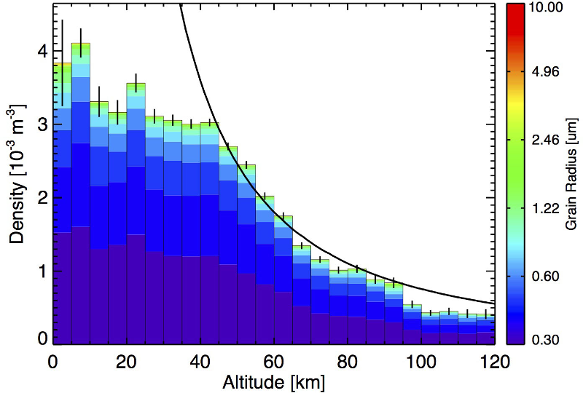
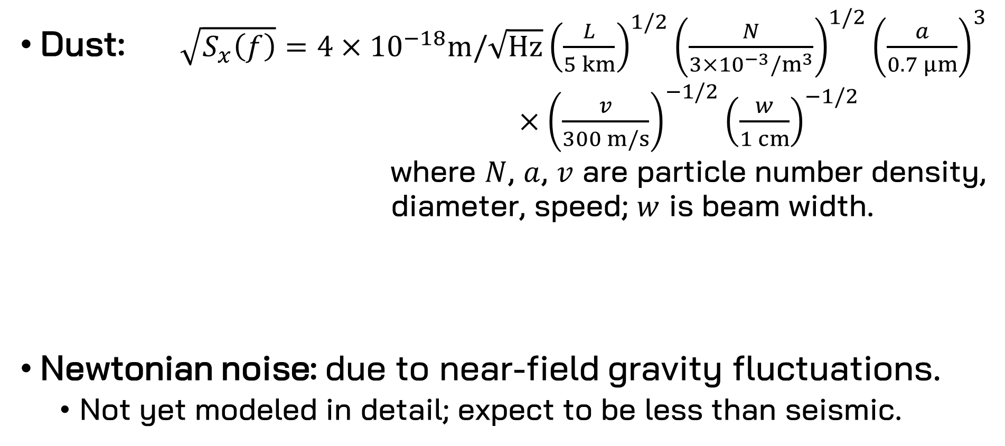
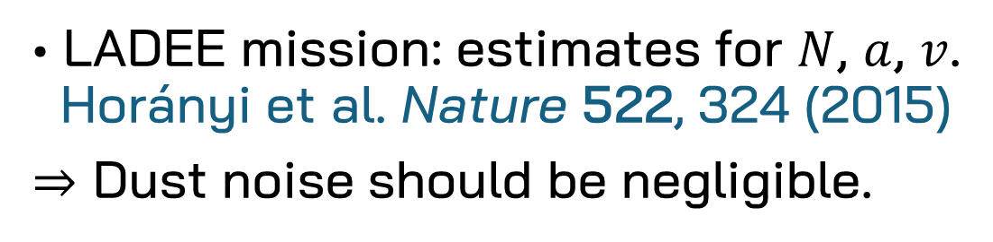
Fundamental Noise Sources
Dust: $\sqrt{S_{x}\left(f\right)}=4×{10}^{−18}m/\sqrt{Hz}{\left(\frac{L}{5 km}\right)}^{1/2}{\left(\frac{N}{3×{10}^{−3}/m^{3}}\right)}^{1/2}{\left(\frac{a}{0.7 μm}\right)}^{3}$
$×{\left(\frac{v}{300 m/s}\right)}^{−1/2}{\left(\frac{w}{1 cm}\right)}^{−1/2}$
where $N$, $a$, $v$ are particle number density,
diameter, speed; $w$ is beam width.
Newtonian noise: due to near-field gravity fluctuations.
  Not yet modeled in detail; expect to be less than seismic.
∙ LADEE mission: estimates for $N$, $a$, $v$.
Horányi et al. Nature 522, 324 (2015)
$⇒$ Dust noise should be negligible.

Slide 20


Fundamental Noise Sources
$$\sqrt{S_{x}\left(f\right)} \left(m/\sqrt{Hz}\right)$$
$$f (Hz)$$

Slide 21
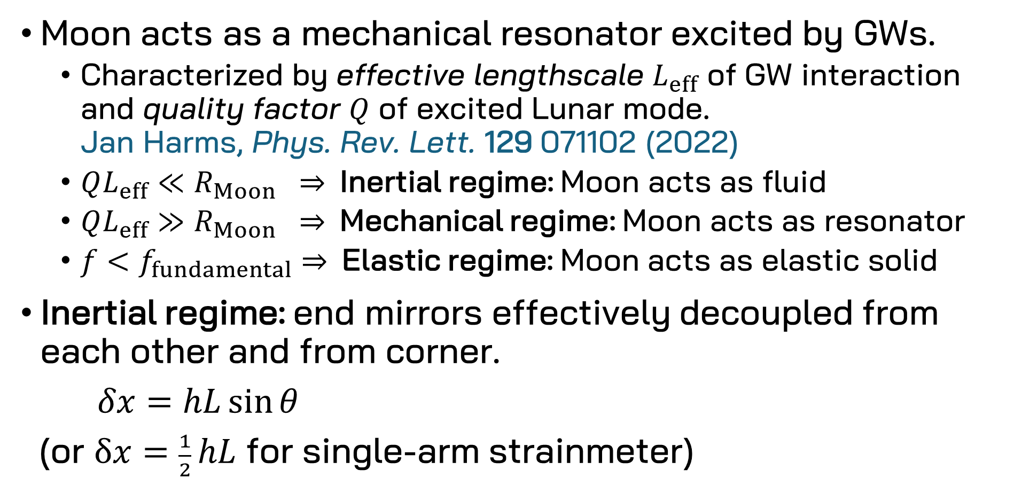
Lunar and Instrumental Response
Moon acts as a mechanical resonator excited by GWs.
  Characterized by effective lengthscale $L_{eff}$ of GW interaction and quality factor $Q$ of excited Lunar mode.
  Jan Harms, Phys. Rev. Lett. 129 071102 (2022)
  $QL_{eff}≪R_{Moon} ⇒$Inertial regime: Moon acts as fluid
  $QL_{eff}≫R_{Moon} ⇒$Mechanical regime: Moon acts as resonator
  $f<f_{fundamental}⇒$Elastic regime: Moon acts as elastic solid
Inertial regime: end mirrors effectively decoupled from each other and from corner.
$δx=hL\sin{θ}$
(or $δx=\frac{1}{2} hL$ for single-arm strainmeter)

Slide 22

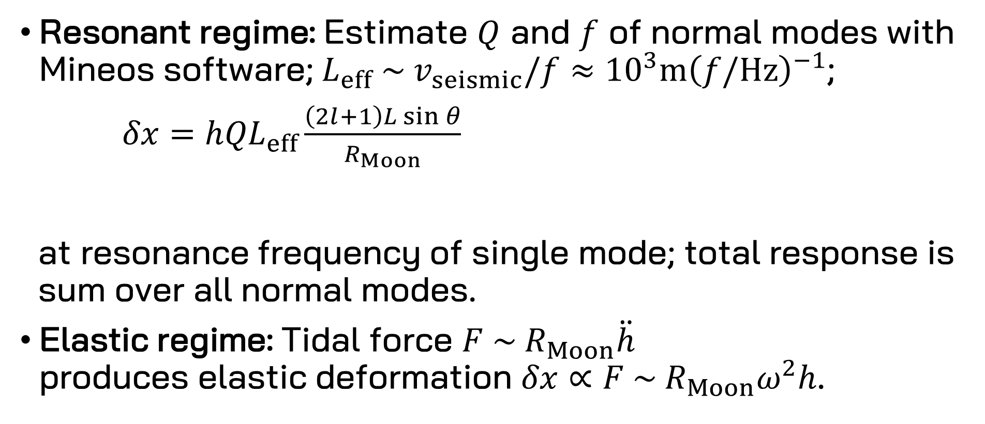

Lunar and Instrumental Response
Resonant regime: Estimate $Q$ and $f$ of normal modes with Mineos software; $L_{eff} \sim v_{seismic}/f≈{10}^{3}m{\left(f/Hz\right)}^{−1}$;
$δx=h{QL}_{eff}\frac{\left(2l+1\right)L\sin{θ}}{R_{Moon}}$
at resonance frequency of single mode; total response is
sum over all normal modes.
Elastic regime: Tidal force $F \sim R_{Moon}\ddot{h}$
produces elastic deformation $δx∝F \sim R_{Moon}ω^{2}h$.
$$\underset{\begin{aligned}\text{surface} \\ \text{movement}\end{aligned}}{\underbrace{ }}$$
$$\underset{\begin{aligned}\text{differential} \\ \text{movement}\end{aligned}}{\underbrace{ }}$$

Slide 23

Lunar and Instrumental Response
$$δx/h (m/strain)$$
$$f (Hz)$$

Slide 24

Lunar and Instrumental Response
$$\sqrt{S_{h}/S_{x}} (strain/m)$$
$$f (Hz)$$

Slide 25
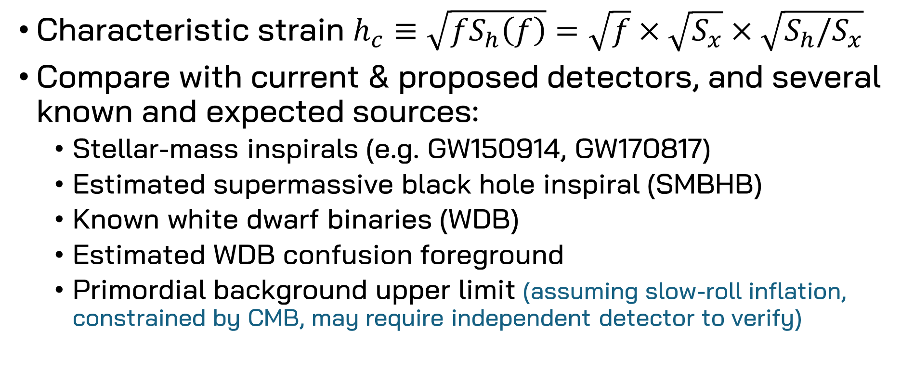
Astrophysical Sensitivity
Characteristic strain $h_{c}≡\sqrt{fS_{h}\left(f\right)}=\sqrt{f}×\sqrt{S_{x}}×\sqrt{S_{h}/S_{x}}$
Compare with current & proposed detectors, and several known and expected sources:
  Stellar-mass inspirals (e.g. GW150914, GW170817)
  Estimated supermassive black hole inspiral (SMBHB)
  Known white dwarf binaries (WDB)
  Estimated WDB confusion foreground
  Primordial background upper limit (assuming slow-roll inflation, constrained by CMB, may require independent detector to verify)

Slide 26
Astrophysical Sensitivity

Slide 27
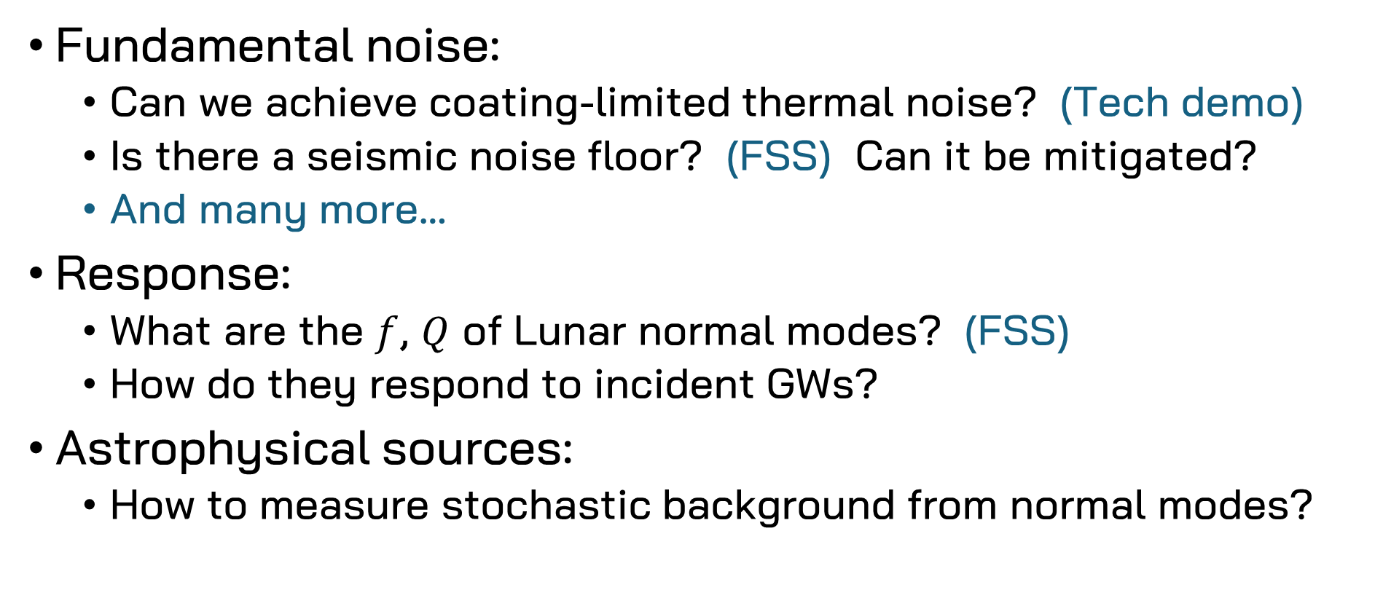
Open Questions
Fundamental noise:
  Can we achieve coating-limited thermal noise? (Tech demo)
  Is there a seismic noise floor? (FSS) Can it be mitigated?
  And many more…
Response:
  What are the $f$, $Q$ of Lunar normal modes? (FSS)
  How do they respond to incident GWs?
Astrophysical sources:
  How to measure stochastic background from normal modes?

